Slide 1
Linux Operating Systems
Taking Control of the Terminal

Slide 2





How are we doing so far?
Notes:
Ask the class about their experiences with Make Art / Advanced Programming

Slide 3

Learning Agenda – Week 7
Operating Systems
  Microsoft (DOS / Windows)
  Apple Computers (MacOS)
  Unix (Before Linux)
  Linux
Who uses Linux?
Why is Linux Cool?
Becoming a Linux Ninja
  Introduction to Terminal Quest
  Live Raspberry Pi – Terminal Session
Notes:
Week 4 – Introduce more conditional operations and looping. By this time the students are pretty familiar with the core programming functions in MakeArt.

Slide 4


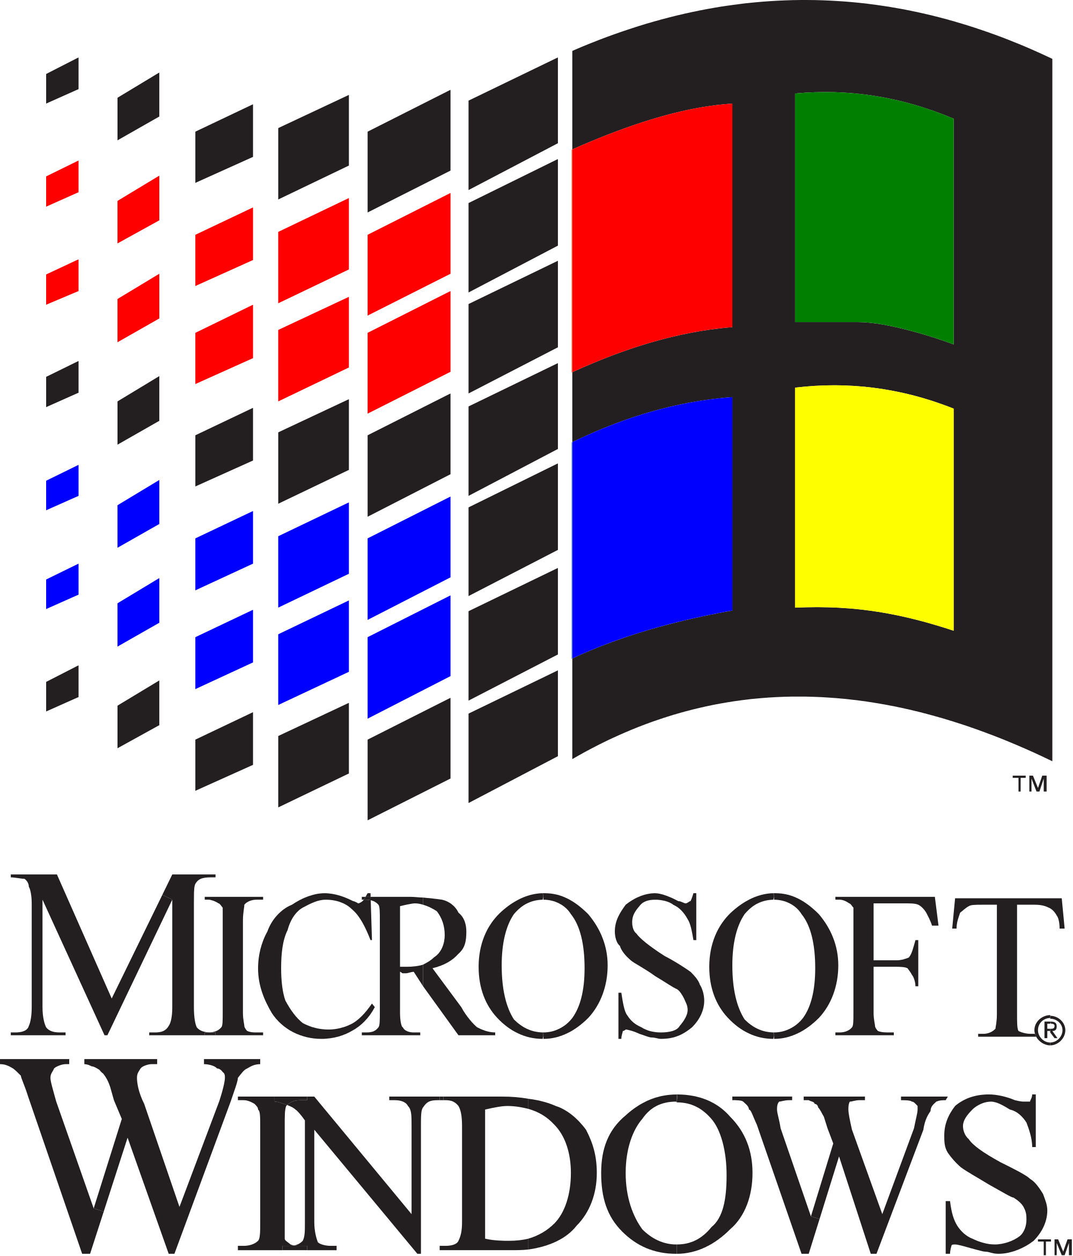



Microsoft DOS / Windows
Microsoft was founded by Paul Allen and Bill Gates (Circa 1975)
Built Altair Basic (1975)
Built MS-DOS (1981)
  Is a non-graphical command line operating system created for IBM compatible computers.
Build Windows (1985)
  Is a graphical operating system shell for MS-DOS in response to the growing interest in graphical user interfaces (GUIs).
  Has grown to be used in smartphones, tablets, embedded devices, and servers.

Slide 5
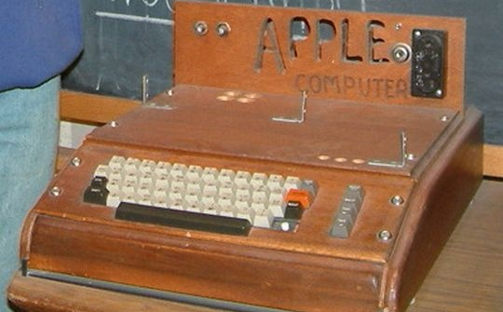
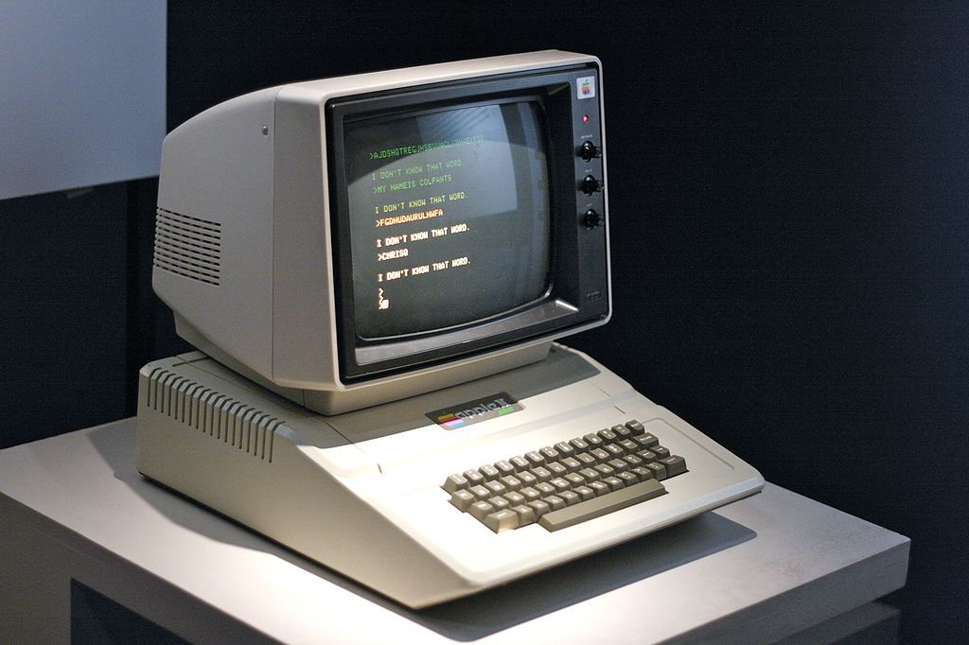
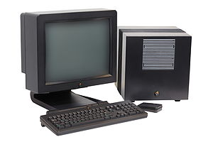
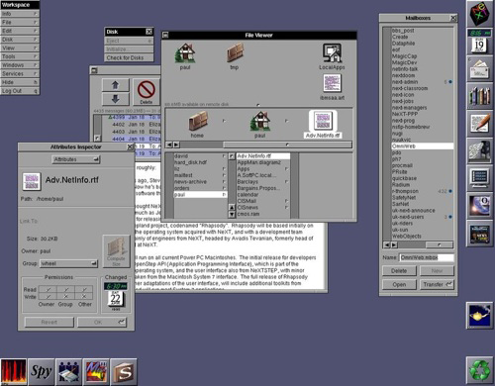

Apple Computer Company
Apple was founded by Steve Jobs, Steve Wozniak, and Ronald Wayne in April 1976 to develop and sell personal computers.
Apple I (1976)
  Sold as an assembled circuit board.
Apple 2 (1977)
  Had major technological advancement over its predecessor.
Macintosh (1984-1991) – Lisa OS
  First personal computer to be sold without a programming language.
Apple Dark Ages (1985-1997)
MacOS X (2001-Present)
  Based on NeXT (Unix OS)
  Berkeley Software Distribution (BSD)
Apple I w/added a keyboard and case
Apple II all-in-one computer
NeXT Cube computer by NeXT Corporation.

Slide 6
Unix (Before Linux)
Unix
  Is a family of multitasking, multiuser computer operating systems that derive from the original AT&T Unix, developed starting in the 1970s at the Bell Labs research center by Ken Thompson and Dennis Ritchie as well as others.
Key Benefits
  Multiuser
  Multitasking
  C Programming Language
  Record Based File System
  Regular Expressions – Deterministic Finite Automata (DFA)
  Modularity and Code Reuse (Great for Tools)
  Supported Networking (ARPANET)
Licensed for Commercial and Educational Use
  In 1975, the cost was a brutal $20,000 for commercial use.
  It was still too expensive for students at $150, per license.
Notes:
Ask students if they know what Multiuser means?
Ask students if they know what Multitasking is?

Slide 7
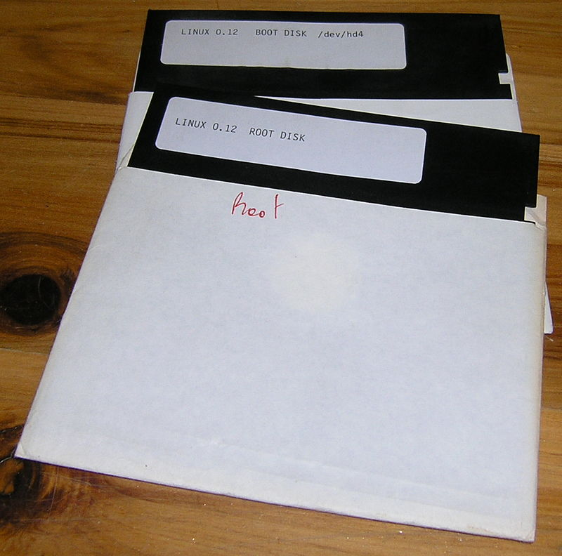
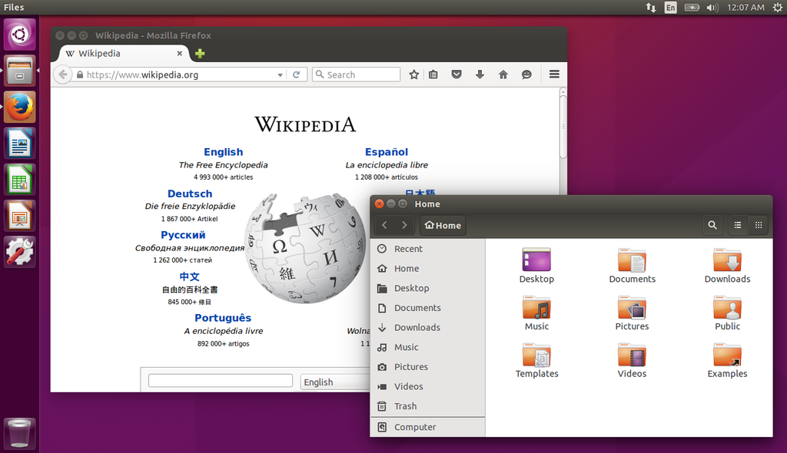
Linux
Created by Linux Torvalds (1991)
  He was frustrated by the licensing of MINIX, a Unix-like operating system.
  He began to work on his own operating system kernel, which eventually became the Linux kernel.
  Still Developed by Linux Torvalds + Others
Licensing (GNU General Public License)
  Free Operating System for All
  Open Source Software
Many, Many, Many versions of Linux
  Android, Ubuntu, Redhat, CentOS, Kindle, Roku, Samsung TVs, and the list goes on.

Slide 8








Who Uses Linux?

Slide 9
What Makes Linux Cool?
It’s completely FREE
It’s an open-source project
It can be modified by anyone
Insanely powerful operating system
Awesome to learn software development
Gives you full control of your hardware
Runs on almost anything (microwaves to rockets)
Great for rapid prototyping
Look like a Ninja when you are on the command line.
Box E. Tops is running Linux + Microcontroller

Slide 10
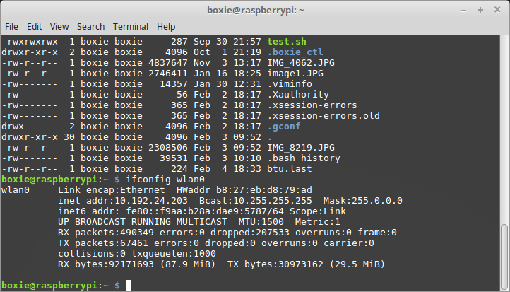
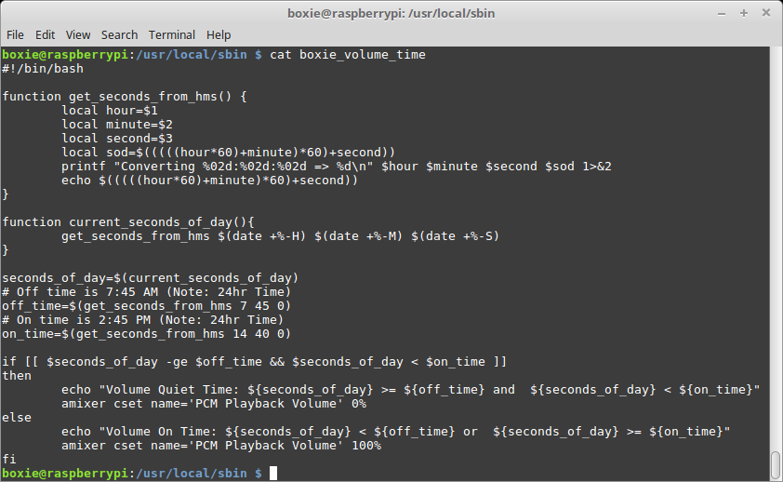
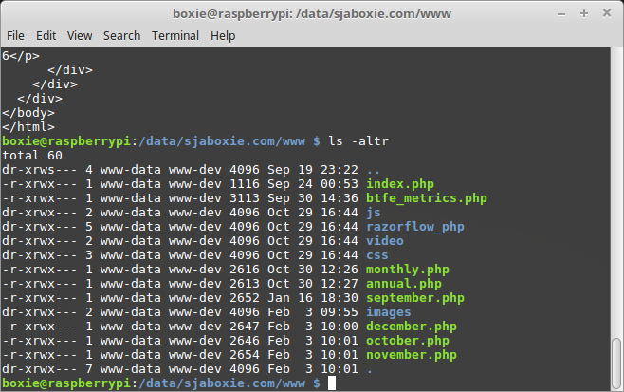
The Linux Shell is Awesome! – Use the Force

Slide 11
Introducing Terminal Quest
It’s all about commands so remember what you type.
How to find things located on a Unix and Linux system.
How to navigate the Linux and Unix filesystems.
How to view the contents of files.
How to move files between directories.
How to print text to the terminal or store it in a file.
How to make new directories (aka Folders).
How to remove files (delete)
How to edit files

Slide 12
Live Raspberry Pi - View
Work at your own pace or follow along ☺

Slide 13
Week 7 - Review
How do you look around? (list contents of a directory)
How do you move an object? (move a file)
How do you change rooms? (change directories)
How do you print text to the screen?
How do you delete an object? (delete a file)
How do you list the contents of an object?
How do you edit a file in the shell?
How do you make a directory?
How do you read permissions of a file or directory?

