Slide 1
Advanced Programing in
MakeArt
(Part 3)

Slide 2





How are we doing so far?
Notes:
Learning something new is exciting and joyful, however; there will be times you feel like ripping your hair out.
Some of you may feel disgusted or sad if and when you can’t get something to work.
The only emotion I would like you all to throw away is ”Fear”, during this class you have nothing to be afraid of.
We will be hacking and modifying things but the best part is even if we break something it’s easy to get things working again.
By learning what not to do, you implicitly learn the right things to do.
The main thing I want all of you to do is learn something new and explore the wonderful world of computing.

Slide 3

Learning Agenda – Week 6
  Introduction to Objects and Classes
    Thinking in Objects
    Class Structure
    Member Variables
    Methods
  Looping
    For Loop
    While Loop
  Convert Advanced Graphing Program to Object
Notes:
Week 4 – Introduce more conditional operations and looping. By this time the students are pretty familiar with the core programming functions in MakeArt.

Slide 4
Thinking in Objects
Think of an object as a way to model the real world.
Objects have an is-a and has-a relationship.
  A an Employee is-a person.
  A company has-a(n) employee(s).
  A person doesn’t have to be an employee.
Person
Name : string
Age : string
Gender : string
--------------------------
+getName() : string
+getAge() : string
+getGender: string
Company (has-a) Employee
Employees : Employee[]
------------------------
+getName() : String
+getEmployee(id) : Employee
Name: String
+getEmployees() : Employee[]
Employee (is-a) Person
SSN : string
Position : string
Email : string
------------------------
+getEmail() : String
+getSSN() : String
+getPosition() : String
ID: integer
+getID() : integer

Slide 5
What’s a Class?
In object-oriented programming, a class is an extensible program-code-template for creating objects, providing initial values for state (member variables) and implementations of behavior (member functions or methods).
CoffeeScript Class Example
# This is a comment and helps make your code readable
class Cartesian
constructor: (@center_x , @center_y) ->
@my_internal_variable = 10
Constructor Arguments
Class Constructor
Class Name
Keyword Specifies Class Definition
Notes:
Review CoffeeScript Functions

Slide 6
What’s a Method?
A method is similar to a function, but is internal to part of a class. The term method is used almost exclusively in object-oriented programming. A function is something that takes a bunch of inputs and returns one or more values.
CoffeeScript Function Example
ThisIsAMethod: (argument1, argument2) ->
result = argument1 + argument2
# This is a comment and helps make your code readable
return result
Method Arguments
Function Body
Return Value
Return Statement
Function Name
Notes:
Review CoffeeScript Functions

Slide 7
What’s a Member Variable?
In object-oriented programming, a member variable (sometimes called a member field) is a variable that is associated with a specific object, and accessible for all its methods (member functions).
CoffeeScript Member Variable
@my_age = 10
@first = “Spongebob”
Value of Integer Type
Value of String Type
Assignment Operator
Variable Name
Notes:
Review CoffeeScript Variables

Slide 8
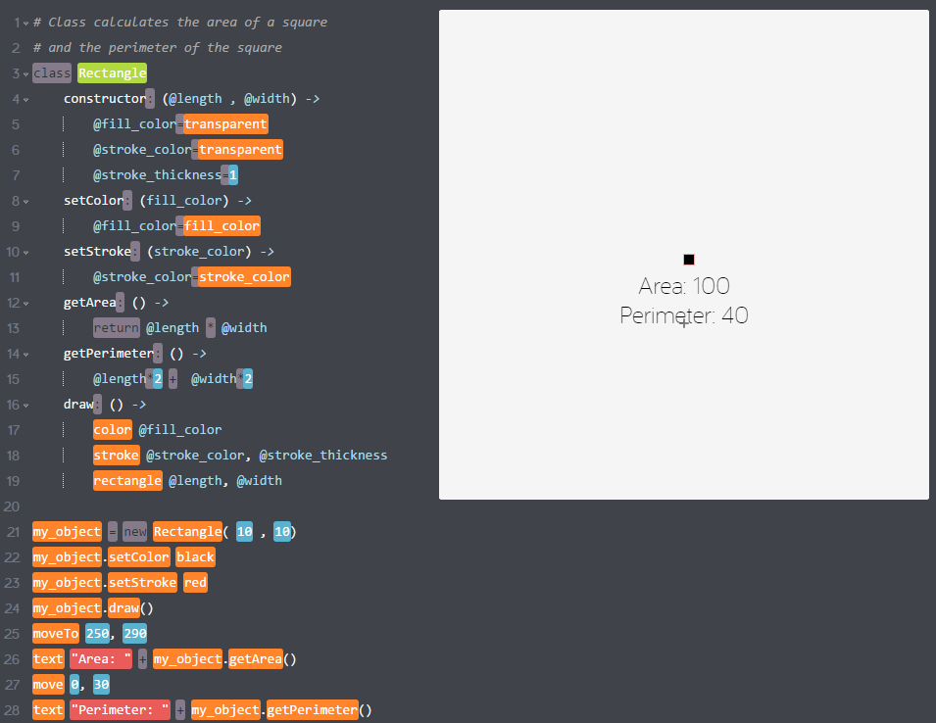
Putting it all together
When a “new” object is created. The class constructor is called. The process is called “Instantiation” or creating a new instance of a class.
The “new” keyword is used to “create” and instance of a class. A class instance is known as an Object. The constructor is called with 10 for @length and 10 for @width.
Notes:
# Class calculates the area of a square
# and the perimeter of the square
class Rectangle
constructor: (@length , @width) ->
@fill_color=transparent
@stroke_color=transparent
@stroke_thickness=1
setColor: (fill_color) ->
@fill_color=fill_color
setStroke: (stroke_color) ->
@stroke_color=stroke_color
getArea: () ->
return @length * @width
getPerimeter: () ->
@length*2 + @width*2
draw: () ->
color @fill_color
stroke @stroke_color, @stroke_thickness
rectangle @length, @width
my_object = new Rectangle( 10 , 10)
my_object.setColor black
my_object.setStroke red
my_object.draw()
moveTo 250, 290
text "Area: " + my_object.getArea()
move 0, 30
text "Perimeter: " + my_object.getPerimeter()

Slide 9
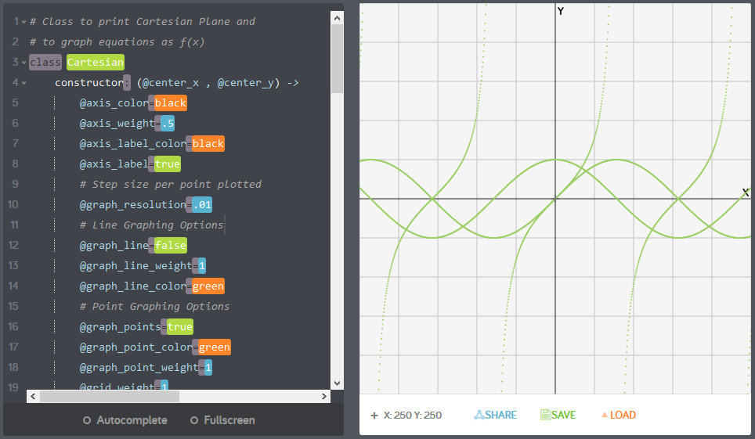
Rewrite the Procedural Program to an Object
Notes:
Concept of Objects – Introduction but not an assignment. Will create a future section on CoffeeScript Objects.
# Class to print Cartesian Plane and
# to graph equations as f(x)
class Cartesian
constructor: (@center_x , @center_y) ->
@axis_color=black
@axis_weight=.5
@axis_label_color=black
@axis_label=true
# Step size per point plotted
@graph_resolution=.01
# Line Graphing Options
@graph_line=false
@graph_line_weight=1
@graph_line_color=green
# Point Graphing Options
@graph_points=true
@graph_point_color=green
@graph_point_weight=1
@grid_weight=1
@grid_color=lightgray
@pixels_per_unit=50
draw_axis: ->
stroke @axis_color, @axis_weight
# Draw Axis Lines Y
moveTo 0 , @center_y
line 500, 0
# Draw Axis Lines Y
moveTo @center_x , 0
line 0, 500
draw_grid: ->
# Draw X lines
stroke @grid_color, @grid_weight
for pos in [ @center_y-@pixels_per_unit .. 0 ] by -@pixels_per_unit
moveTo 0 , pos
line 500, 0
for pos in [ @center_y+@pixels_per_unit .. 500 ] by @pixels_per_unit
moveTo 0 , pos
line 500, 0
for pos in [ @center_x-@pixels_per_unit .. 0 ] by -@pixels_per_unit
moveTo pos , 0
line 0, 500
for pos in [ @center_x+@pixels_per_unit .. 500 ] by @pixels_per_unit
moveTo pos , 0
line 0, 500
draw_labels : ->
color @axis_label_color
bold true
font 15
moveTo @center_x , @center_y
move (500-@center_x)-7 , -3
text "X"
moveTo @center_x , 0
move 7, 15
text "Y"
draw_plane: ->
this.draw_grid()
this.draw_axis()
this.draw_labels()
graph: ( equation ) ->
if (@graph_resolution <= 0)
@graph_resolution = 1
x_min=-@center_x/@pixels_per_unit
x_max=(500-@center_x)/@pixels_per_unit
if @graph_line
# Don't draw first line
stroke 0
for x_in in [ x_min .. x_max ] by @graph_resolution
y_out = equation(x_in)
lineTo (x_in*@pixels_per_unit)+@center_x , -(y_out*@pixels_per_unit)+@center_y
moveTo (x_in*@pixels_per_unit)+@center_x , -(y_out*@pixels_per_unit)+@center_y
stroke @graph_line_color, @graph_line_weight
if @graph_points
# Dont add stroke thickness to point
stroke 0
for x_in in [ x_min .. x_max ] by @graph_resolution
y_out = equation(x_in)
moveTo (x_in*@pixels_per_unit)+@center_x , -(y_out*@pixels_per_unit)+@center_y
color @graph_point_color
circle @graph_point_weight
my_graph = new Cartesian( 250, 250 )
# Draw the plane
my_graph.draw_plane()
# Graph some functions
my_graph.graph (x) -> Math.sin(x)
my_graph.graph (x) -> Math.cos(x)
my_graph.graph (x) -> Math.tan(x)

Slide 10
Week 6 - Review
What is a class?
What is a method?
What is an object?
What is a constructor?
How do you define member variables?
How do you define a method?

