Slide 1
Advanced Programing in
MakeArt
(Part 2)

Slide 2





How are we doing so far?
Notes:
Learning something new is exciting and joyful, however; there will be times you feel like ripping your hair out.
Some of you may feel disgusted or sad if and when you can’t get something to work.
The only emotion I would like you all to throw away is ”Fear”, during this class you have nothing to be afraid of.
We will be hacking and modifying things but the best part is even if we break something it’s easy to get things working again.
By learning what not to do, you implicitly learn the right things to do.
The main thing I want all of you to do is learn something new and explore the wonderful world of computing.

Slide 3

Learning Agenda – Week 5
Review Advanced Programming (Part 1)
  Boolean Logic
    And, Or, Not
    Conditions (Comparison)
  Function & Variable Definition Structure
No More Training Wheels Part 2
  Conditional (IF) Programming Logic
    Greater Than or Equal To
    Less Than or Equal To
  Looping
    For Loop
    While Loop
  Make a Graph (Basic / Advanced)
Notes:
Week 4 – Introduce more conditional operations and looping. By this time the students are pretty familiar with the core programming functions in MakeArt.

Slide 4
The Truth Tables Aren't Lying - Review
AND
OR
NOT
X | Y | X∧Y
0 | 0
0 | 1
1 | 0
1 | 1
X | Y | X∨Y
0 | 0
0 | 1
1 | 0
1 | 1
X | ¬X
0
1
Notes:
Have the class tell you the answers to the truth tables.

Slide 5
What’s a Function?
In programming, a named section of a program that performs a specific task. In this sense, a function is a type of procedure or routine.
CoffeeScript Function Example
ThisIsAFunctionName = (argument1, argument2) ->
result = argument1 + argument2
# This is a comment and helps make your code readable
return result
Function Arguments
Function Body
Return Value
Return Statement
Function Name
Notes:
Review CoffeeScript Functions

Slide 6
What’s a Variable?
In computer programming, a variable or scalar is a storage location paired with an associated symbolic name, which contains some known or unknown quantity of information referred to as a value.
CoffeeScript Variable Examples
my_age = 10
first = “Spongebob”
Value of Integer Type
Value of String Type
Assignment Operator
Variable Name
Notes:
Review CoffeeScript Variables

Slide 7
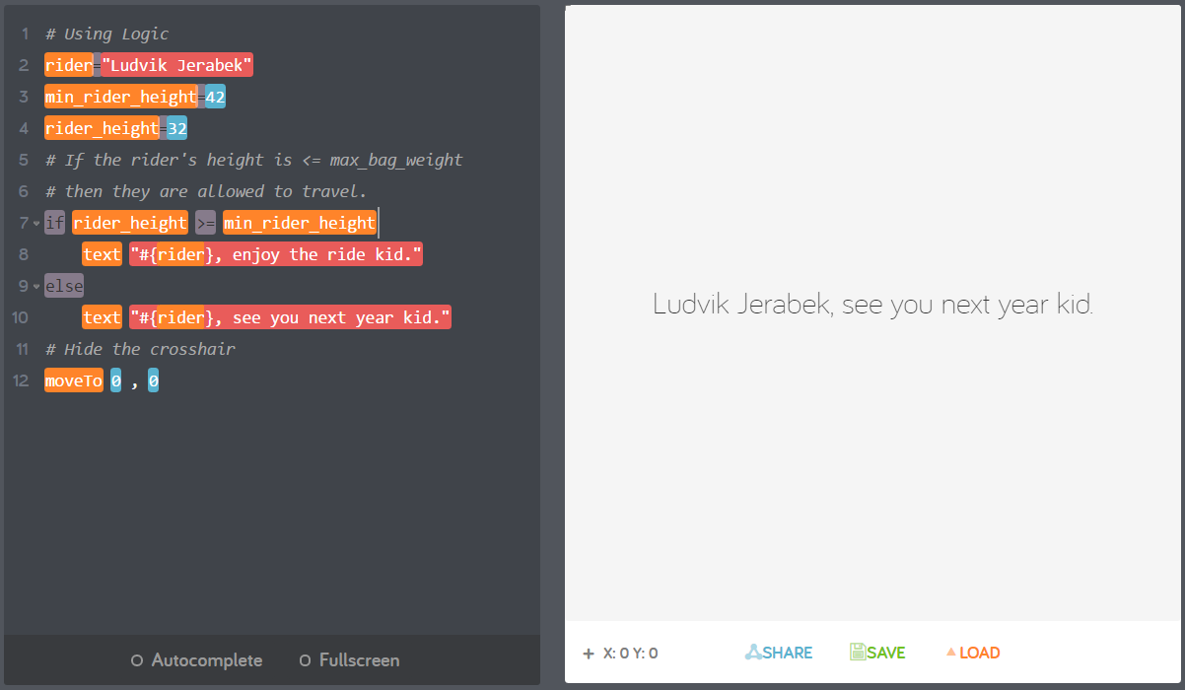
You must be at least 42 inches to ride! (>=)

Slide 8
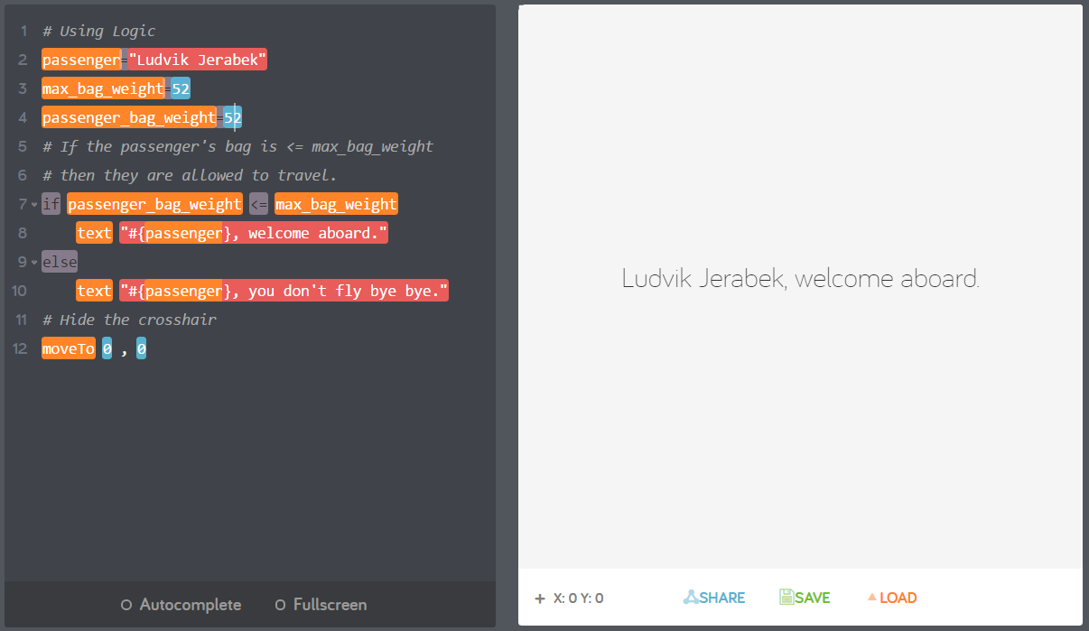
Your bag must weigh 52lbs or less! (<=)

Slide 9
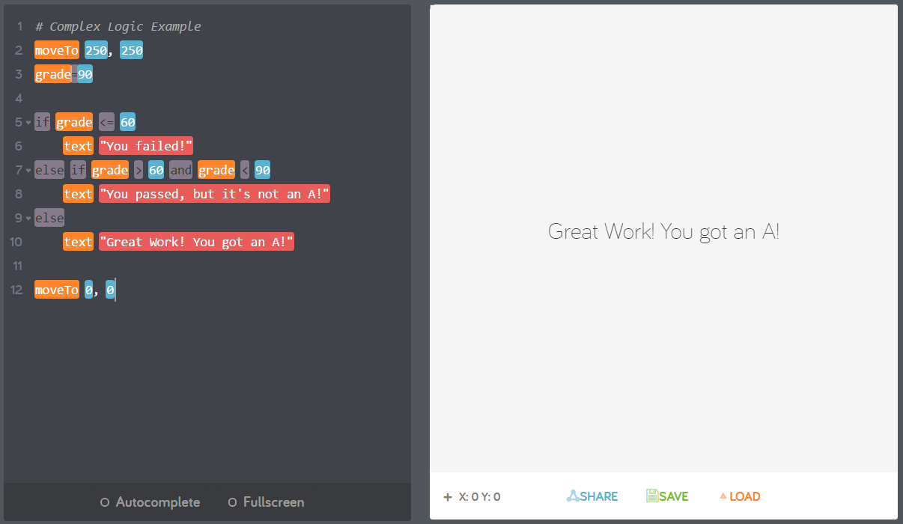
Making Decisions - If, Else If, Else

Slide 10
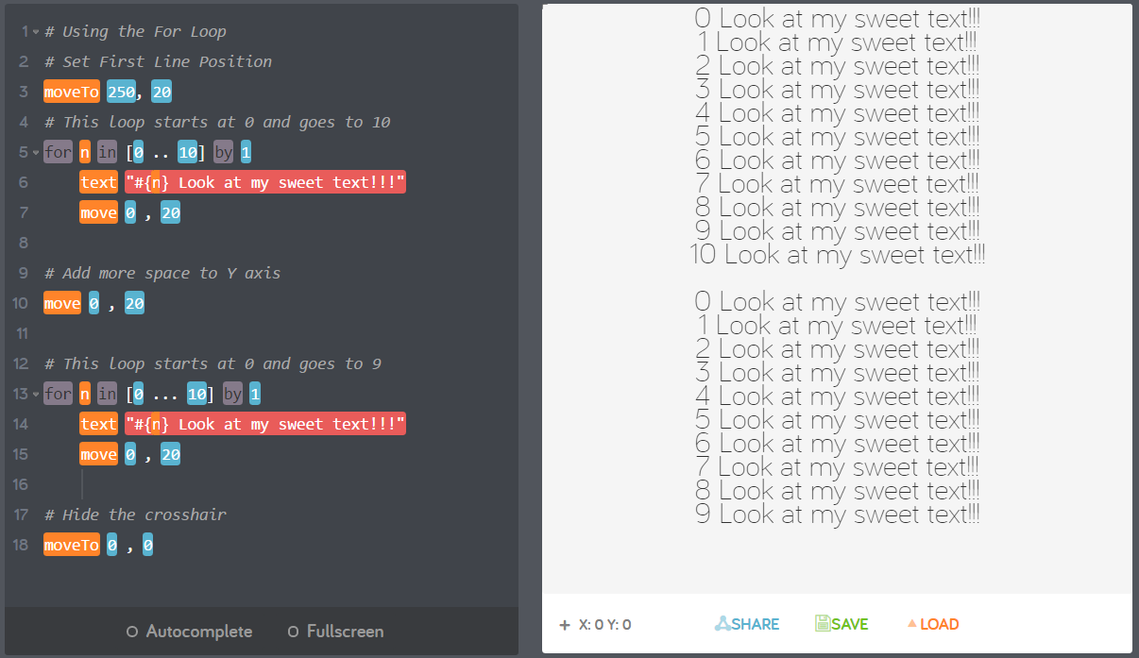
Rinse and Repeat – The for loop

Slide 11
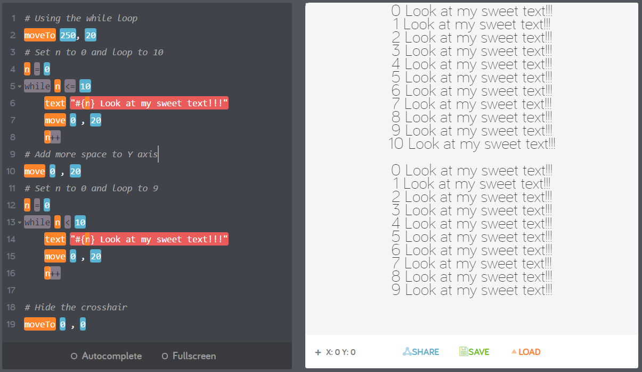
While the water was running … While Loop

Slide 12
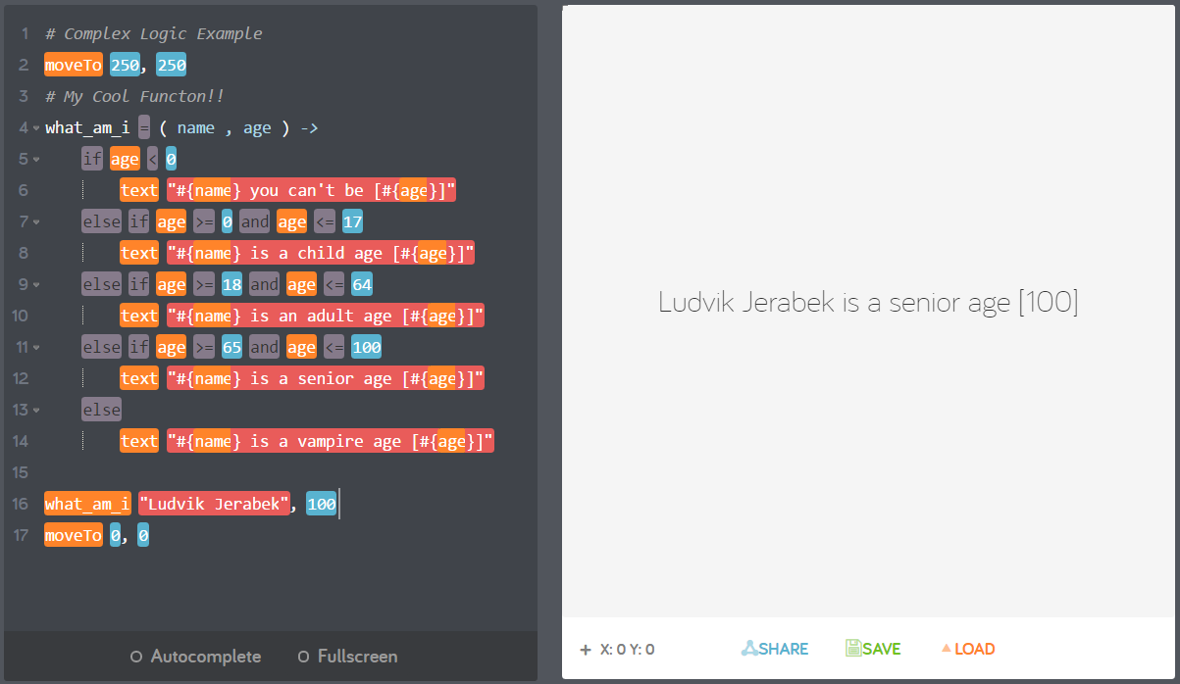
Custom Program – What Am I?
Advanced Programming Assignment
This assignment will test your understanding of functions, logic, and conditional statements. You should be able to use the comparison operators ( >, >=, <, <=, ==, != ) to solve the programming problem.
Program Requirements:
A single function named “what_am_i” or “whatAmI” must be created.
  This function must take two arguments name and age
The function should have logic to satisfy the following requirements:
  Person with age under 0 is not alive and can’t exist.
    Input Example: Willy, -1
    Output Example: Willy you can't be -1
  Person with an age 0 to 17 is a child
    Input Example: John, 1
    Output Example: John is a child age 1
  Person with an age 18 to 64 is an adult
    Input Example: Jane , 64
    Output Example: Jane is an adult age 64
  Person with an age 65 to 100 is a senior
    Input Example: Elanor, 77
    Output Example: Elanor is a senior age 77
  Person with an age greater than 100 is a vampire or dinosaur.
    Input Example: Vladimir , 101
    Output Example: Vladimir is a vampire age 101
HIDDEN ANSWER
Notes:
Advanced Logic Assignment Answer
# Complex Logic Example
moveTo 250, 250
# My Cool Functon!!
what_am_i = ( name , age ) ->
if age < 0
text "#{name} you can't be [#{age}]"
else if age >= 0 and age <= 17
text "#{name} is a child age [#{age}]"
else if age >= 18 and age <= 64
text "#{name} is an adult age [#{age}]"
else if age >= 65 and age <= 100
text "#{name} is a senior age [#{age}]"
else
text "#{name} is a vampire age [#{age}]"
moveTo 0, 0
what_am_i "Ludvik Jerabek", 100

Slide 13
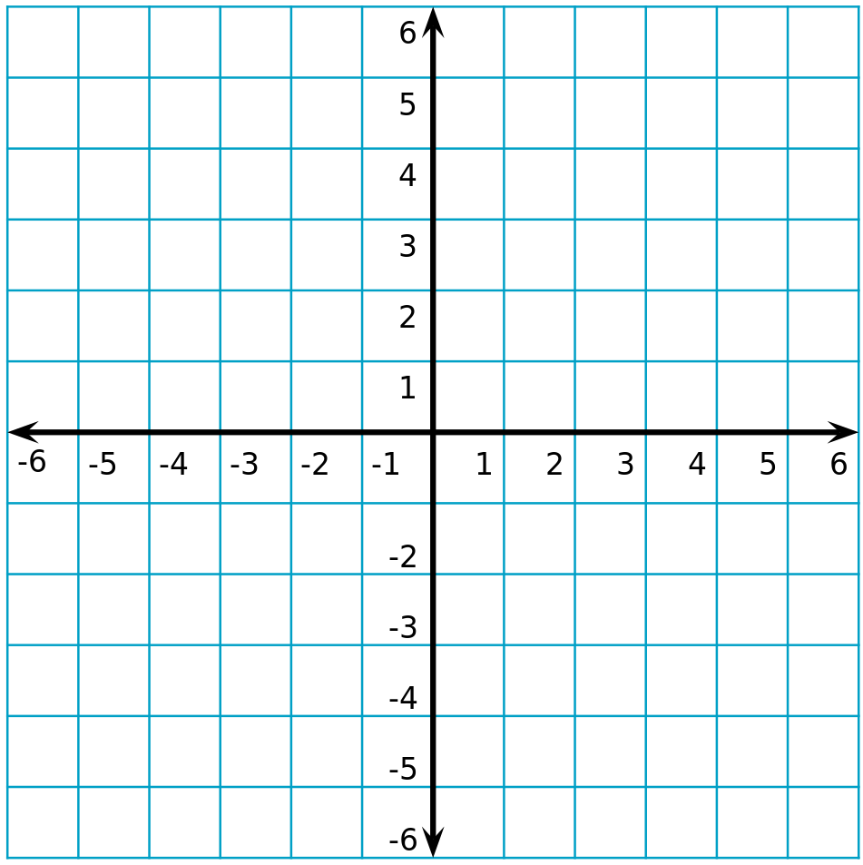
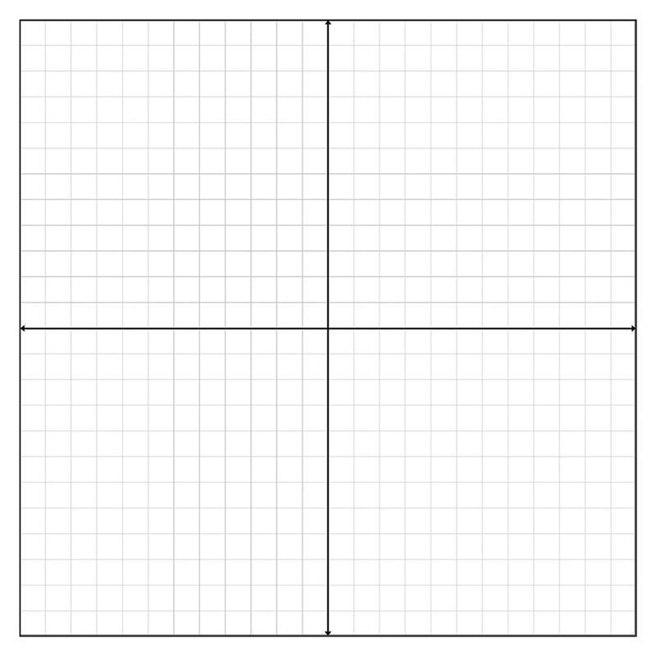
Remember the Cartesian Plane?
(0,0)
(250,250)
(0,0)
(500,500)
Notes:
Review Coordinate Plane… Yes again.. Kids learn by repetition.

Slide 14
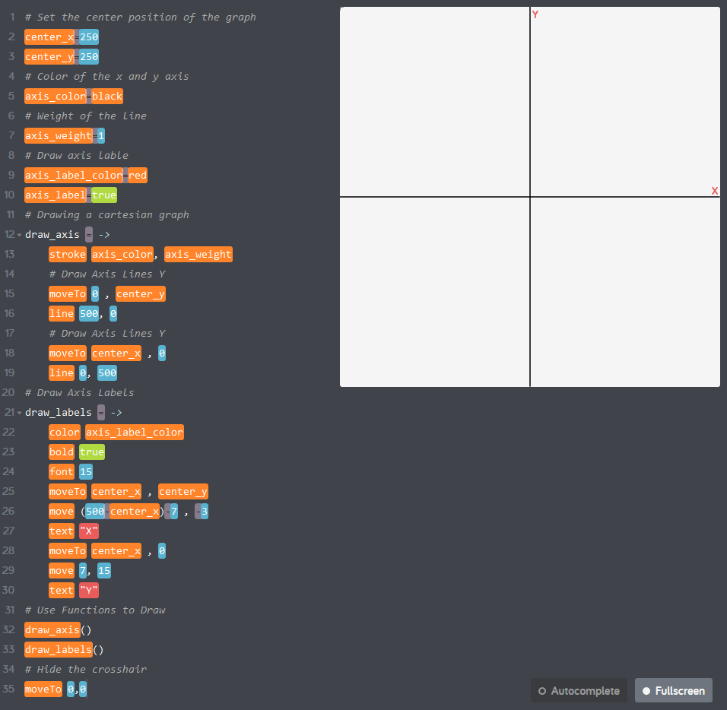
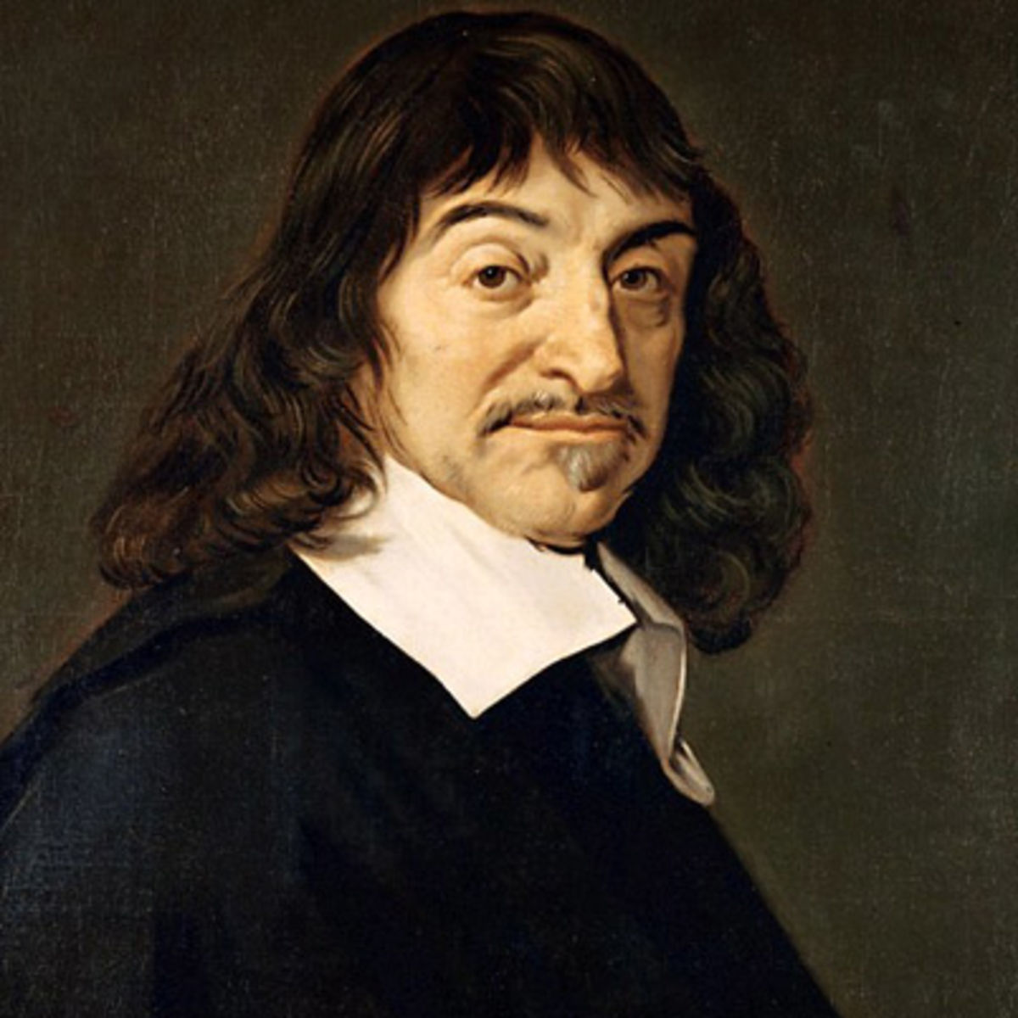
Making René Descartes Proud
The invention of Cartesian coordinates in the 17th century by René Descartes revolutionized mathematics by providing the first systematic link between Euclidean geometry and algebra.
Notes:
Advanced Programming Assignment #2 – Answer
# Set the center position of the graph
center_x=250
center_y=250
# Color of the x and y axis
axis_color=black
# Weight of the line
axis_weight=1
# Draw axis lable
axis_label_color=red
axis_label=true
# Drawing a cartesian graph
draw_axis = ->
stroke axis_color, axis_weight
# Draw Axis Lines Y
moveTo 0 , center_y
line 500, 0
# Draw Axis Lines Y
moveTo center_x , 0
line 0, 500
# Draw Axis Labels
draw_labels = ->
color axis_label_color
bold true
font 15
moveTo center_x , center_y
move (500-center_x)-7 , -3
text "X"
moveTo center_x , 0
move 7, 15
text "Y"
# Use Functions to Draw
draw_axis()
draw_labels()
# Hide the crosshair
moveTo 0,0

Slide 15
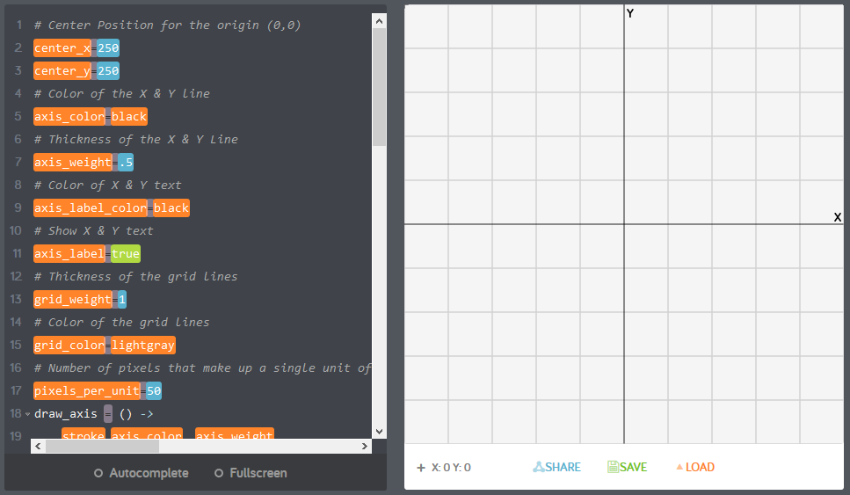
Blowing René Descartes Mind!
Notes:
Advanced Programming Assignment 3 – Answer
# Center Position for the origin (0,0)
center_x=250
center_y=250
# Color of the X & Y line
axis_color=black
# Thickness of the X & Y Line
axis_weight=.5
# Color of X & Y text
axis_label_color=black
# Show X & Y text
axis_label=true
# Thickness of the grid lines
grid_weight=1
# Color of the grid lines
grid_color=lightgray
# Number of pixels that make up a single unit of measure
pixels_per_unit=50
draw_axis = () ->
stroke axis_color, axis_weight
# Draw Axis Lines Y
moveTo 0 , center_y
line 500, 0
# Draw Axis Lines Y
moveTo center_x , 0
line 0, 500
draw_grid = () ->
# Draw X lines
stroke grid_color, grid_weight
for pos in [ center_y-pixels_per_unit .. 0 ] by -pixels_per_unit
moveTo 0 , pos
line 500, 0
for pos in [ center_y+pixels_per_unit .. 500 ] by pixels_per_unit
moveTo 0 , pos
line 500, 0
for pos in [ center_x-pixels_per_unit .. 0 ] by -pixels_per_unit
moveTo pos , 0
line 0, 500
for pos in [ center_x+pixels_per_unit .. 500 ] by pixels_per_unit
moveTo pos , 0
line 0, 500
draw_labels = () ->
color axis_label_color
bold true
font 15
moveTo center_x , center_y
move (500-center_x)-7 , -3
text "X"
moveTo center_x , 0
move 7, 15
text "Y"
draw_plane = ->
draw_grid()
draw_axis()
draw_labels()
moveTo 0 , 0
draw_plane()

Slide 16
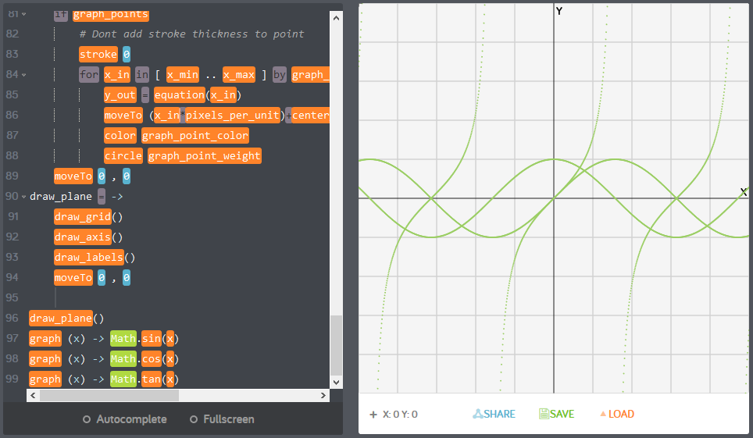
Graphing Calculator! Sin(x), Cos(x), Tan(x)
Notes:
Advanced Programming Assignment 4 – Answer
# Center Position for the origin (0,0)
center_x=250
center_y=250
# Color of the X & Y line
axis_color=black
# Thickness of the X & Y Line
axis_weight=.5
# Color of X & Y text
axis_label_color=black
# Show X & Y text
axis_label=true
# Step size per point plotted
graph_resolution=.01
# Line Graphing Options
# This will enable connecting points by line
graph_line=false
# Thickness of the lines connecting points
graph_line_weight=1
# Color of the lines connecting points
graph_line_color=green
# Point Graphing Options
# Show plotted points
graph_points=true
# Plotted point color
graph_point_color=green
# Radius of the point plotted
graph_point_weight=1
# Grid Options
# Thickness of the grid lines
grid_weight=1
# Color of the grid lines
grid_color=lightgray
# Number of pixels that make up a single unit of measure
pixels_per_unit=50
draw_axis = () ->
stroke axis_color, axis_weight
# Draw Axis Lines Y
moveTo 0 , center_y
line 500, 0
# Draw Axis Lines Y
moveTo center_x , 0
line 0, 500
draw_grid = () ->
# Draw X lines
stroke grid_color, grid_weight
for pos in [ center_y-pixels_per_unit .. 0 ] by -pixels_per_unit
moveTo 0 , pos
line 500, 0
for pos in [ center_y+pixels_per_unit .. 500 ] by pixels_per_unit
moveTo 0 , pos
line 500, 0
for pos in [ center_x-pixels_per_unit .. 0 ] by -pixels_per_unit
moveTo pos , 0
line 0, 500
for pos in [ center_x+pixels_per_unit .. 500 ] by pixels_per_unit
moveTo pos , 0
line 0, 500
draw_labels = () ->
color axis_label_color
bold true
font 15
moveTo center_x , center_y
move (500-center_x)-7 , -3
text "X"
moveTo center_x , 0
move 7, 15
text "Y"
graph = ( equation ) ->
if (graph_resolution <= 0)
graph_resolution = 1
x_min=-center_x/pixels_per_unit
x_max=(500-center_x)/pixels_per_unit
if graph_line
# Don't draw first line
stroke 0
for x_in in [ x_min .. x_max ] by graph_resolution
y_out = equation(x_in)
lineTo (x_in*pixels_per_unit)+center_x , -(y_out*pixels_per_unit)+center_y
moveTo (x_in*pixels_per_unit)+center_x , -(y_out*pixels_per_unit)+center_y
stroke graph_line_color, graph_line_weight
if graph_points
# Dont add stroke thickness to point
stroke 0
for x_in in [ x_min .. x_max ] by graph_resolution
y_out = equation(x_in)
moveTo (x_in*pixels_per_unit)+center_x , -(y_out*pixels_per_unit)+center_y
color graph_point_color
circle graph_point_weight
moveTo 0 , 0
draw_plane = ->
draw_grid()
draw_axis()
draw_labels()
moveTo 0 , 0
draw_plane()
graph (x) -> Math.sin(x)
graph (x) -> Math.cos(x)
graph (x) -> Math.tan(x)

Slide 17
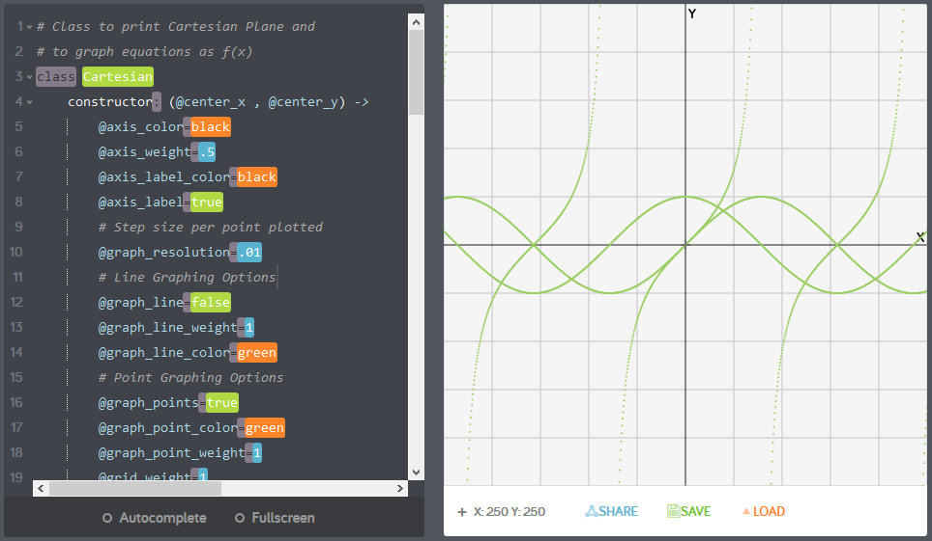
Doing it with class!
Notes:
Concept of Objects – Introduction but not an assignment. Will create a future section on CoffeeScript Objects.
# Class to print Cartesian Plane and
# to graph equations as f(x)
class Cartesian
constructor: (@center_x , @center_y) ->
@axis_color=black
@axis_weight=.5
@axis_label_color=black
@axis_label=true
# Step size per point plotted
@graph_resolution=.01
# Line Graphing Options
@graph_line=false
@graph_line_weight=1
@graph_line_color=green
# Point Graphing Options
@graph_points=true
@graph_point_color=green
@graph_point_weight=1
@grid_weight=1
@grid_color=lightgray
@pixels_per_unit=50
draw_axis: ->
stroke @axis_color, @axis_weight
# Draw Axis Lines Y
moveTo 0 , @center_y
line 500, 0
# Draw Axis Lines Y
moveTo @center_x , 0
line 0, 500
draw_grid: ->
# Draw X lines
stroke @grid_color, @grid_weight
for pos in [ @center_y-@pixels_per_unit .. 0 ] by -@pixels_per_unit
moveTo 0 , pos
line 500, 0
for pos in [ @center_y+@pixels_per_unit .. 500 ] by @pixels_per_unit
moveTo 0 , pos
line 500, 0
for pos in [ @center_x-@pixels_per_unit .. 0 ] by -@pixels_per_unit
moveTo pos , 0
line 0, 500
for pos in [ @center_x+@pixels_per_unit .. 500 ] by @pixels_per_unit
moveTo pos , 0
line 0, 500
draw_labels : ->
color @axis_label_color
bold true
font 15
moveTo @center_x , @center_y
move (500-@center_x)-7 , -3
text "X"
moveTo @center_x , 0
move 7, 15
text "Y"
draw_plane: ->
this.draw_grid()
this.draw_axis()
this.draw_labels()
graph: ( equation ) ->
if (@graph_resolution <= 0)
@graph_resolution = 1
x_min=-@center_x/@pixels_per_unit
x_max=(500-@center_x)/@pixels_per_unit
if @graph_line
# Don't draw first line
stroke 0
for x_in in [ x_min .. x_max ] by @graph_resolution
y_out = equation(x_in)
lineTo (x_in*@pixels_per_unit)+@center_x , -(y_out*@pixels_per_unit)+@center_y
moveTo (x_in*@pixels_per_unit)+@center_x , -(y_out*@pixels_per_unit)+@center_y
stroke @graph_line_color, @graph_line_weight
if @graph_points
# Dont add stroke thickness to point
stroke 0
for x_in in [ x_min .. x_max ] by @graph_resolution
y_out = equation(x_in)
moveTo (x_in*@pixels_per_unit)+@center_x , -(y_out*@pixels_per_unit)+@center_y
color @graph_point_color
circle @graph_point_weight
my_graph = new Cartesian( 250, 250 )
# Draw the plane
my_graph.draw_plane()
# Graph some functions
my_graph.graph (x) -> Math.sin(x)
my_graph.graph (x) -> Math.cos(x)
my_graph.graph (x) -> Math.tan(x)

Slide 18
Week 5 - Review
Give an example of AND logic.
Give an example of OR logic.
Give an example of NOT logic.
What is a loop?
  Write an example of a “For” loop
  Write an example of a “While” loop
What is wrong with the following loop?
  n=99
  while n < 100
  text “This is #{n}”
  n--

