Slide 1
Advanced Programing in
MakeArt
(Part 1)

Slide 2
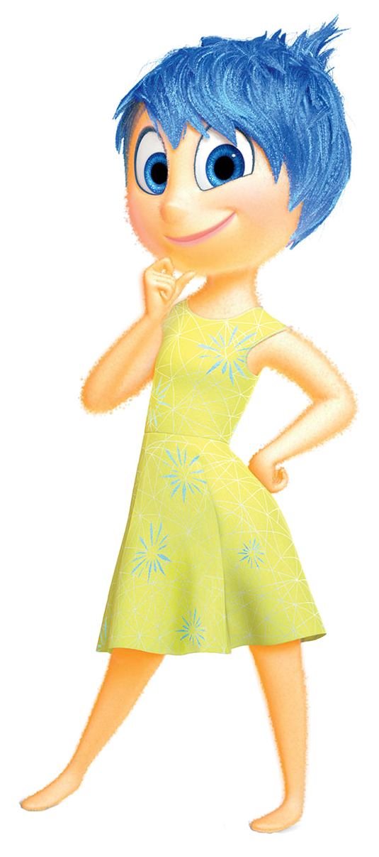
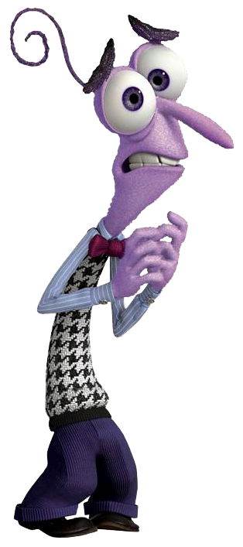
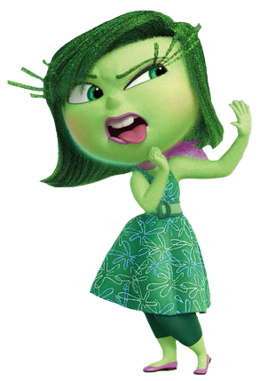


How are we doing so far?
Notes:
Learning something new is exciting and joyful, however; there will be times you feel like ripping your hair out.
Some of you may feel disgusted or sad if and when you can’t get something to work.
The only emotion I would like you all to throw away is ”Fear”, during this class you have nothing to be afraid of.
We will be hacking and modifying things but the best part is even if we break something it’s easy to get things working again.
By learning what not to do, you implicitly learn the right things to do.
The main thing I want all of you to do is learn something new and explore the wonderful world of computing.

Slide 3
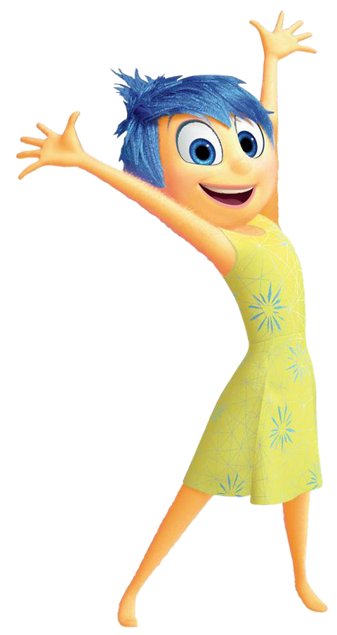
Learning Agenda – Week 4
Introduction to Boolean Logic
  Father of Boolean Logic
  And, Or, Not
  Conditions
  Why do we need this logic?
No More Training Wheels
  Function Definition Structure
  Variable Definition Structure
  Write Your Own Code
    Create and use custom function
    Create and use custom variables
    Conditional (IF) Programming Logic
      Equal To and Not Equal To
      Greater Than and Less Than
Notes:
Week 3 we introduce more theory and application. By this time the students are pretty familiar with the core programming functions in MakeArt.

Slide 4
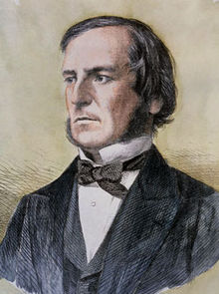

Introduction to Boolean Logic
He was an English mathematician, educator, philosopher and logician. He worked in the fields of differential equations and algebraic logic, and is best known as the author of The Laws of Thought which contains Boolean algebra.
Boolean logic is credited with laying the foundations for the information age.
Let’s Start Thinking in Boolean
1 = True
0= False
George Boole
Nov, 2 1815 – Dec, 8 1864

Slide 5
Boolean Logic - AND, OR, NOT
AND (conjunction), denoted X∧Y or sometimes X AND Y
  The Rule: X∧Y = 1, If and only if X = 1 and Y = 1
  All other cases are 0
X
Y

Slide 6
Boolean Logic - AND, OR, NOT
OR (disjunction), denoted X∨Y or sometimes X OR Y
  The Rule: X∨Y = 0, If and only if X = 0 and Y = 0
  All other cases are 1
X
Y

Slide 7
Boolean Logic - AND, OR, NOT
NOT (negation), denoted ¬X or sometimes NOT X
  Rule ¬X = 0, If and only if X = 1
  Rule ¬X = 1, If and only if X = 0
X

Slide 8
The Truth Tables Aren't Lying
AND
OR
NOT
X | Y | X∧Y
0 | 0 | 0
0 | 1 | 0
1 | 0 | 0
1 | 1 | 1
X | Y | X∨Y
0 | 0 | 0
0 | 1 | 1
1 | 0 | 1
1 | 1 | 1
X | ¬X
0 | 1
1 | 0

Slide 9
Conditions Result in Boolean Results
Logical statements are either True or False.
For a value of X and Y evaluate the following statements:
  If X == Y = ?
  If X < Y = ?
  If X > Y = ?
  If X >= Y = ?
  If X <= Y = ?
  If X != Y = ?
What other conditions can we have?
Notes:
These are numeric conditions, but what other conditions can we have?

Slide 10
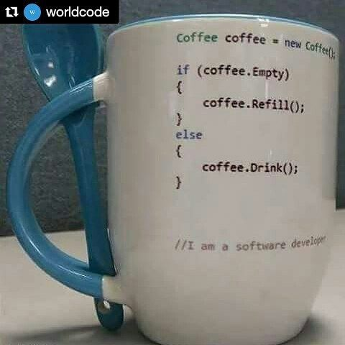
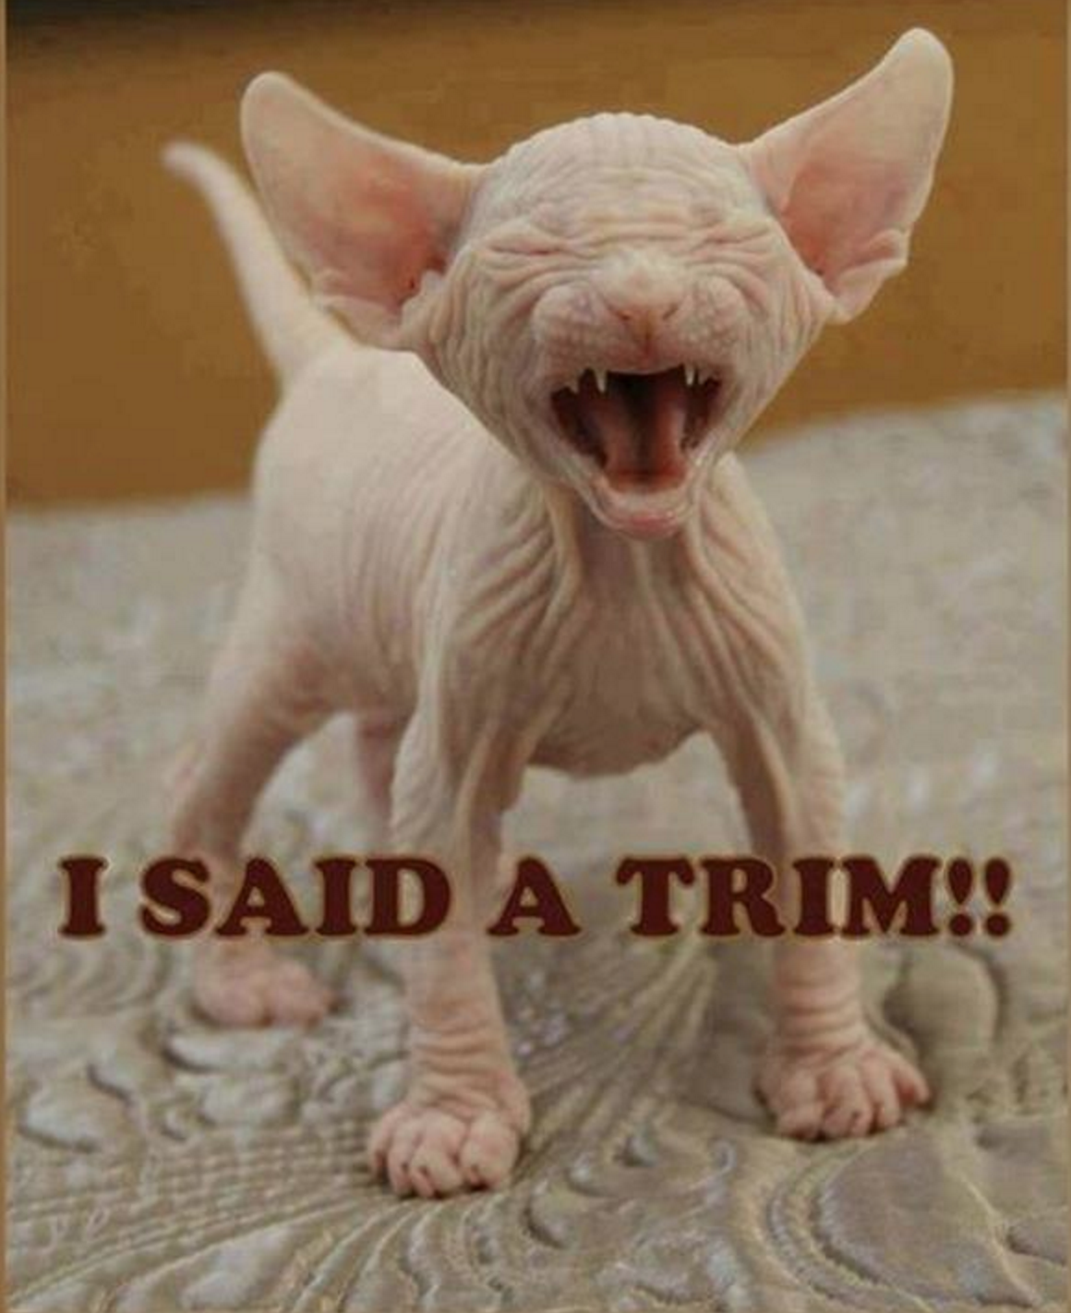
Why do we need logic?
To control what a program will do and how it will do it.

Slide 11

No More Training Wheels
You knew it was coming…

Slide 12
What’s a Function?
In programming, a named section of a program that performs a specific task. In this sense, a function is a type of procedure or routine.
CoffeeScript Function Example
ThisIsAFunctionName = (argument1, argument2) ->
result = argument1 + argument2
# This is a comment and helps make your code readable
return result
Function Arguments
Function Body
Return Value
Return Statement
Function Name

Slide 13
What’s a Variable?
In computer programming, a variable or scalar is a storage location paired with an associated symbolic name, which contains some known or unknown quantity of information referred to as a value.
CoffeeScript Variable Examples
my_age = 10
first = “Spongebob”
Value of Integer Type
Value of String Type
Assignment Operator
Variable Name

Slide 14
What’s a Function?
In programming, a named section of a program that performs a specific task. In this sense, a function is a type of procedure or routine.
C++ Function Example
int ThisIsAFunctionName (int x, int y)
int result = x + y;
// This is a comment and helps make your code readable
return result;
{
}
Function Arguments
Function Body
Return Value
Return Statement
Function Name
Return Type

Slide 15
What’s a Variable?
In computer programming, a variable or scalar is a storage location paired with an associated symbolic name, which contains some known or unknown quantity of information referred to as a value.
C++ Variable Examples
int my_age = 10;
std::string first = “Spongebob”;
Variable Type
Integer Value
Semicolon End of Statement
String Literal
Assignment Operator
Variable Name
Variable Type
Namespace
Notes:
Exposing the kids to different programming languages.
Discuss the differences in the syntax.
Discuss namespaces (high level)
Discuss primitives vs ADTs
Discuss string literals (char arrays) vs. string objects.

Slide 16
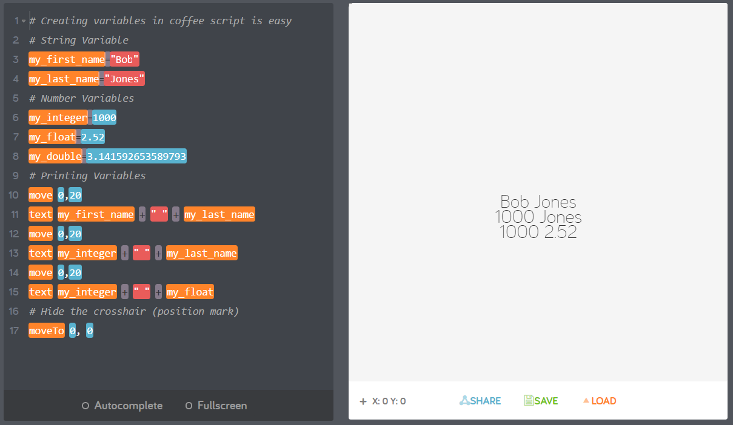
My First Program With Variables

Slide 17
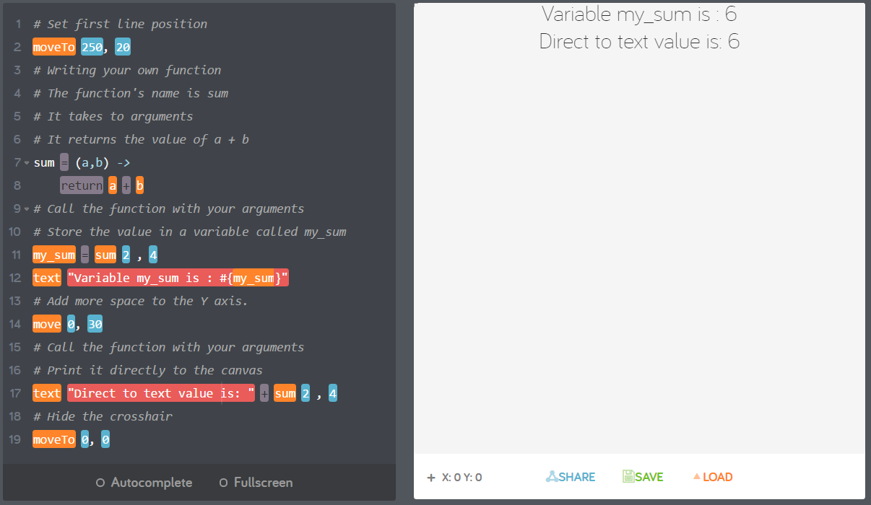
Call me if you need that done! - Functions

Slide 18
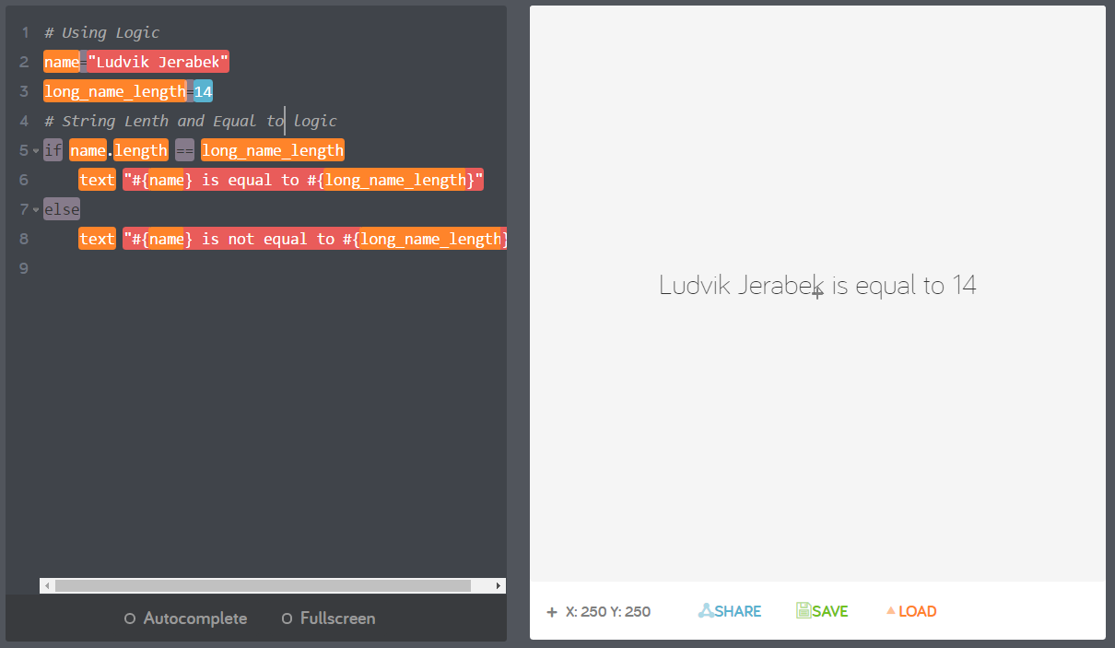
Are you the same? – Equals Logic (==)

Slide 19
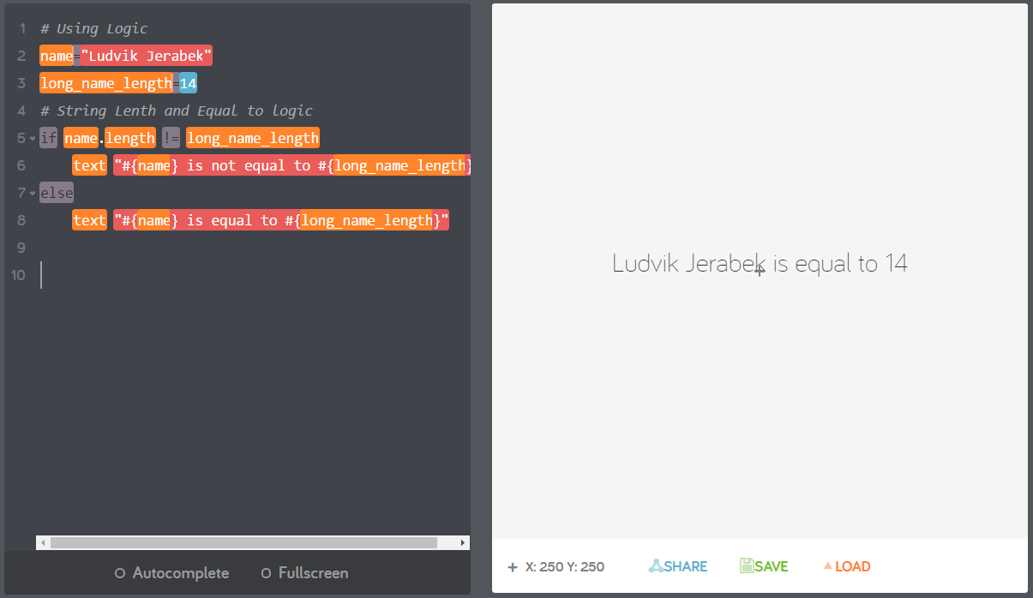
To Be or Not To Be – Not Equals Logic (!=)

Slide 20
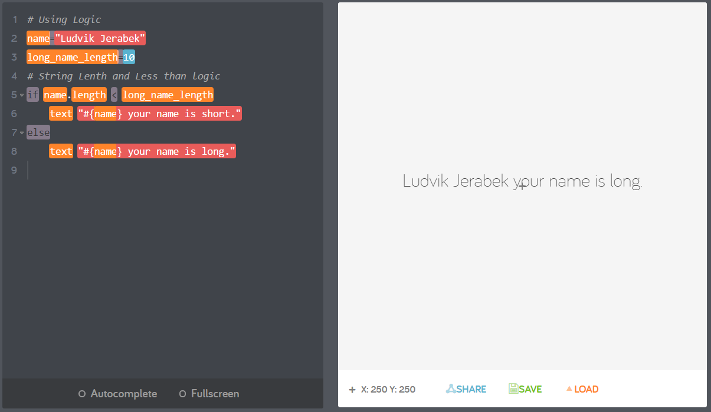
Are you smaller?– Less Than (<)

Slide 21
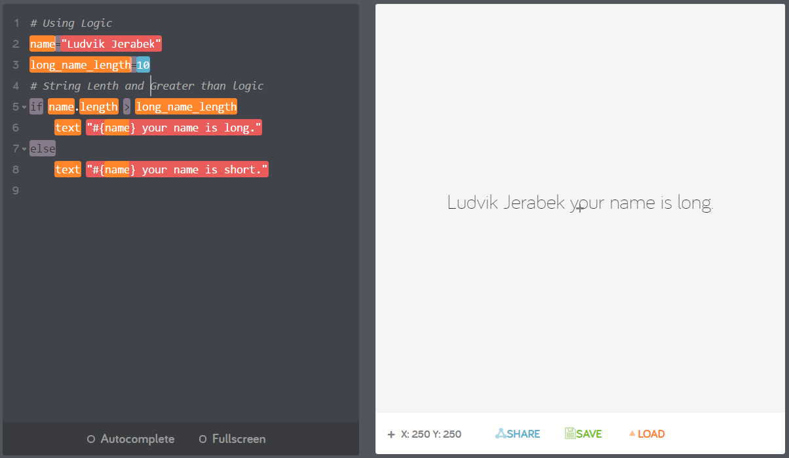
Are you larger?– Greater Than (>)

Slide 22
Week 4 - Review
Who is the father of Boolean logic?
What is a conditional? (give an example)
What is the result of a condition?
Why do we need logic?
Give an example of AND logic.
Give an example of OR logic.
Give an example of NOT logic.

