Slide 1
Introduction to Programing for
Artists

Slide 2
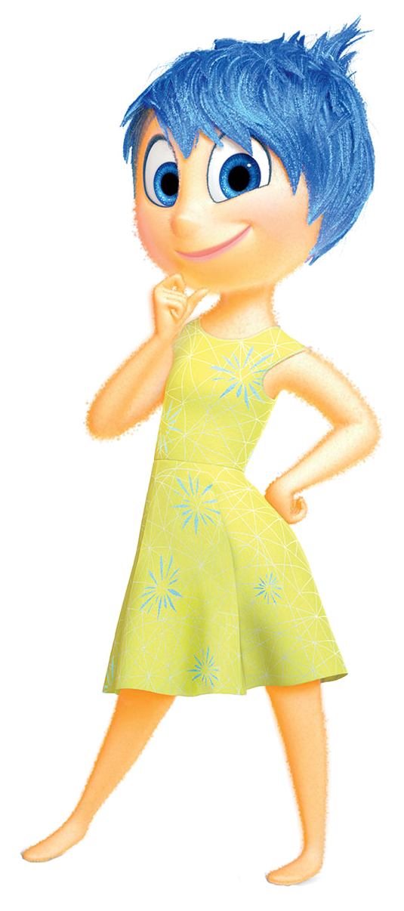
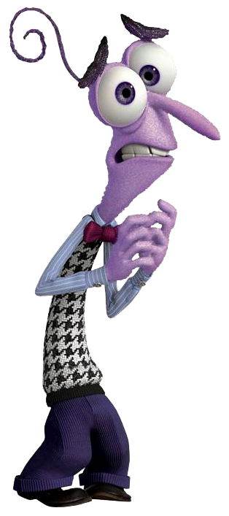
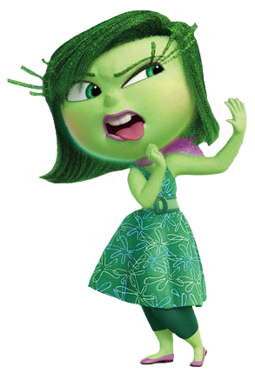


How are we doing so far?
Notes:
Learning something new is exciting and joyful, however; there will be times you feel like ripping your hair out.
Some of you may feel disgusted or sad if and when you can’t get something to work.
The only emotion I would like you all to throw away is ”Fear”, during this class you have nothing to be afraid of.
We will be hacking and modifying things but the best part is even if we break something it’s easy to get things working again.
By learning what not to do, you implicitly learn the right things to do.
The main thing I want all of you to do is learn something new and explore the wonderful world of computing.

Slide 3
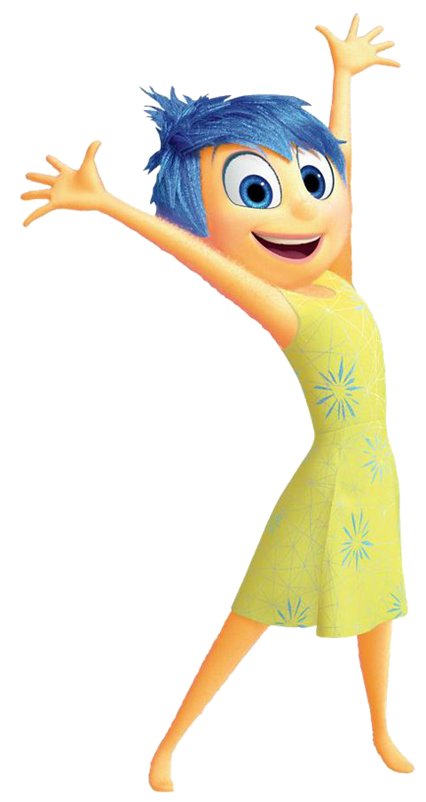
Learning Agenda – Week 3
What’s MakeArt?
  CoffeeScript and Javascript
  What are Functions?
    MakeArt Functions
Let’s Make Art with Code
  Learn to navigate the coordinate plane
  Learn to draw basic shapes
  Learn to generate random numbers
  Draw some really cool custom images with code.
World Flag Project
Notes:
This week we cut back on Computer Science theory and allow the kids to explore programming in MakeArt.

Slide 4


What’s MakeArt?
MakeArt is an Integrated Development Environment (IDE) designed to teach kids code by using art.
The programming language we will be using is known as CoffeeScript.
CoffeeScript is a language that compiles into JavaScript and is an attempt to expose the good parts of JavaScript in a simple way.
It’s just JavaScript (JS)!
The code compiles one-to-one into the equivalent JS, and there is no interpretation at runtime.
This is a real programming language used by professional programmers.
Notes:
Ask who has heard of Java Script?

Slide 5
What’s a Function?
In programming, a named section of a program that performs a specific task. In this sense, a function is a type of procedure or routine.
CoffeeScript Function Example
ThisIsAFunctionName = (argument1, argument2) ->
result = argument1 + argument2
# This is a comment and helps make your code readable
return result
Function Arguments
Function Body
Return Value
Return Statement
Function Name
Notes:
Introduction to the concept of a function and how a function is defined in CoffeeScript.

Slide 6
What’s a Function?
In programming, a named section of a program that performs a specific task. In this sense, a function is a type of procedure or routine.
C++ Function Example
int ThisIsAFunctionName (int x, int y)
int result = x + y;
// This is a comment and helps make your code readable
return result;
{
}
Function Arguments
Function Body
Return Value
Return Statement
Function Name
Return Type
Notes:
Show them how that same function is defined in C++ and discuss the similarities and differences.

Slide 7
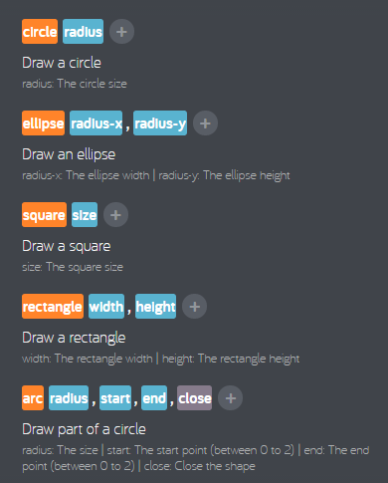
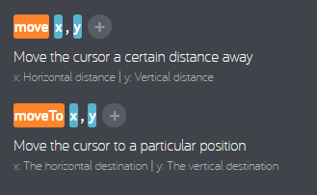
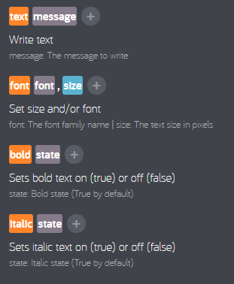
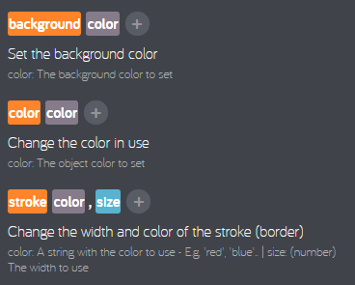
Make Art Functions
Notes:
This is a core set of the MakeArt drawing and navigation functions that you will use. Can someone tell me the arguments the Move or MoveTo function take?

Slide 8
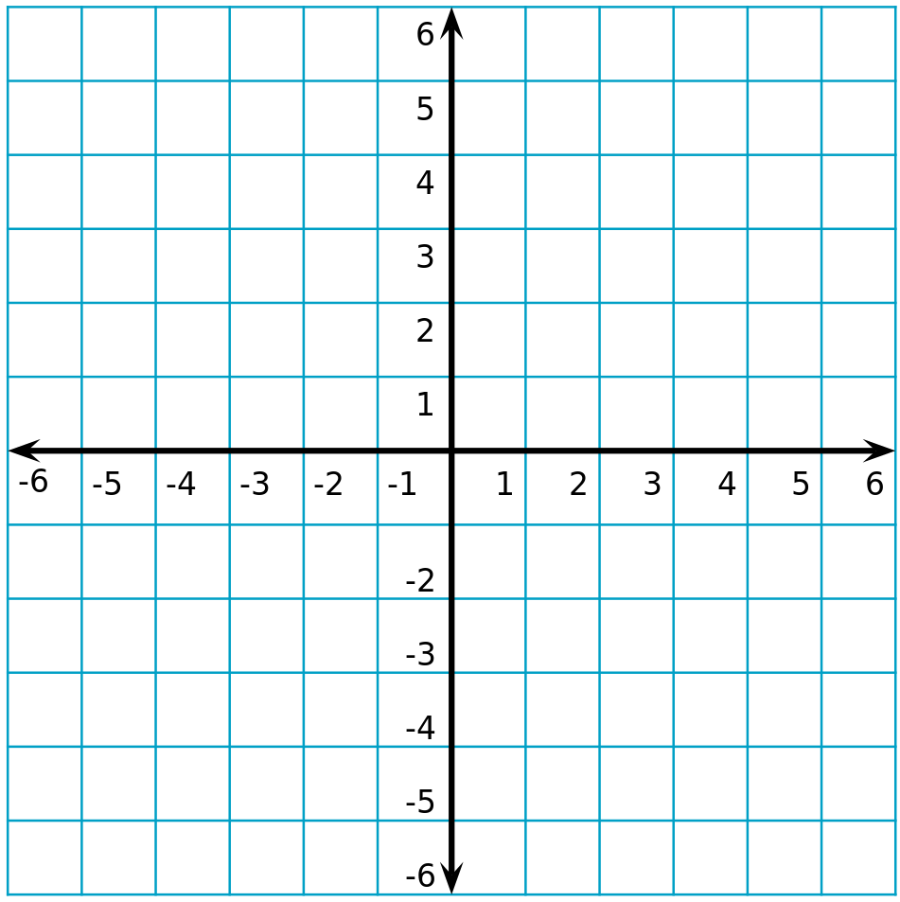
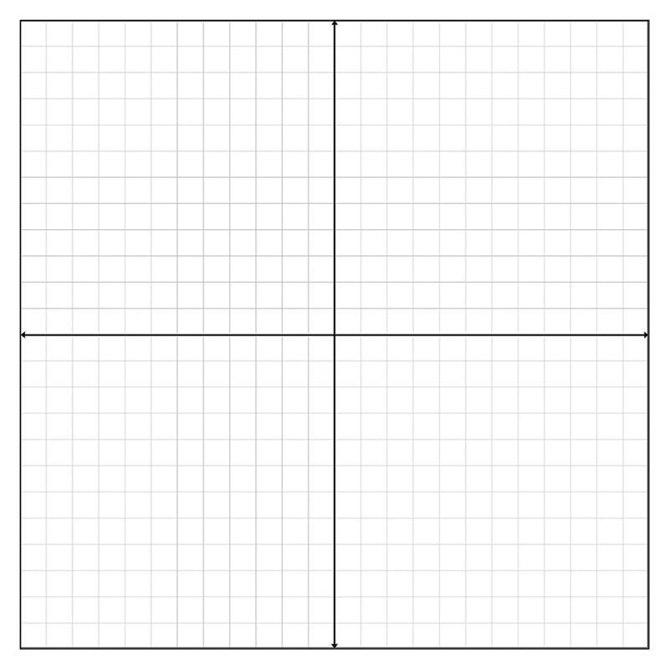
The Make Art Canvas – Cartesian Plane
(0,0)
(250,250)
(0,0)
(500,500)
Notes:
Introduction to coordinate planes. On the left they probably have seen this in math class. On the right is the representation of x & y in the make art cavas.

Slide 9
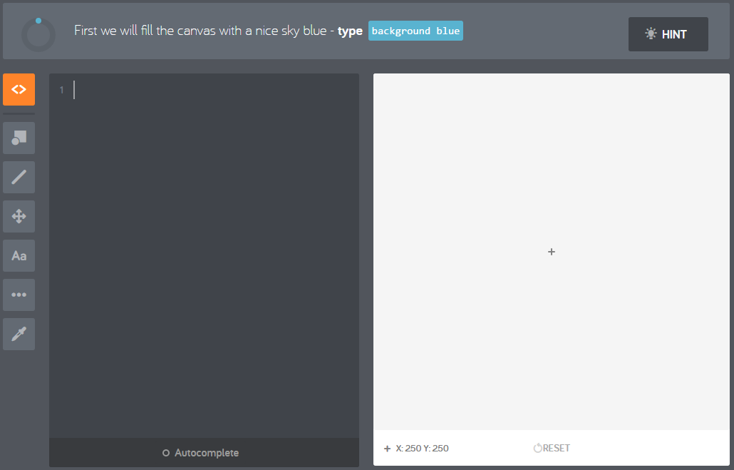
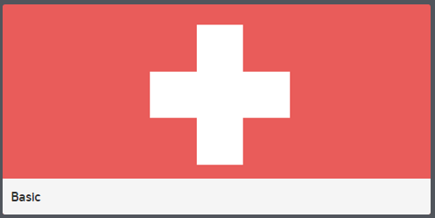
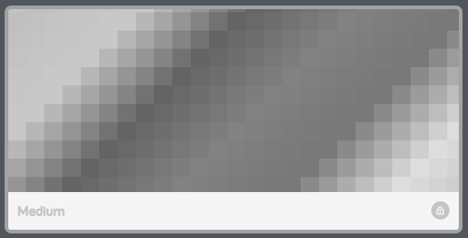
Launch Make Art – Basic and Medium
Start with Basic
After Basic, Start Medium
Notes:
Have the kids launch MakeArt, and begin the Basic drawing exercises. Remind them to remember the functions they use for the programing.
Note: Medium is grey until the basic exercises are completed.

Slide 10
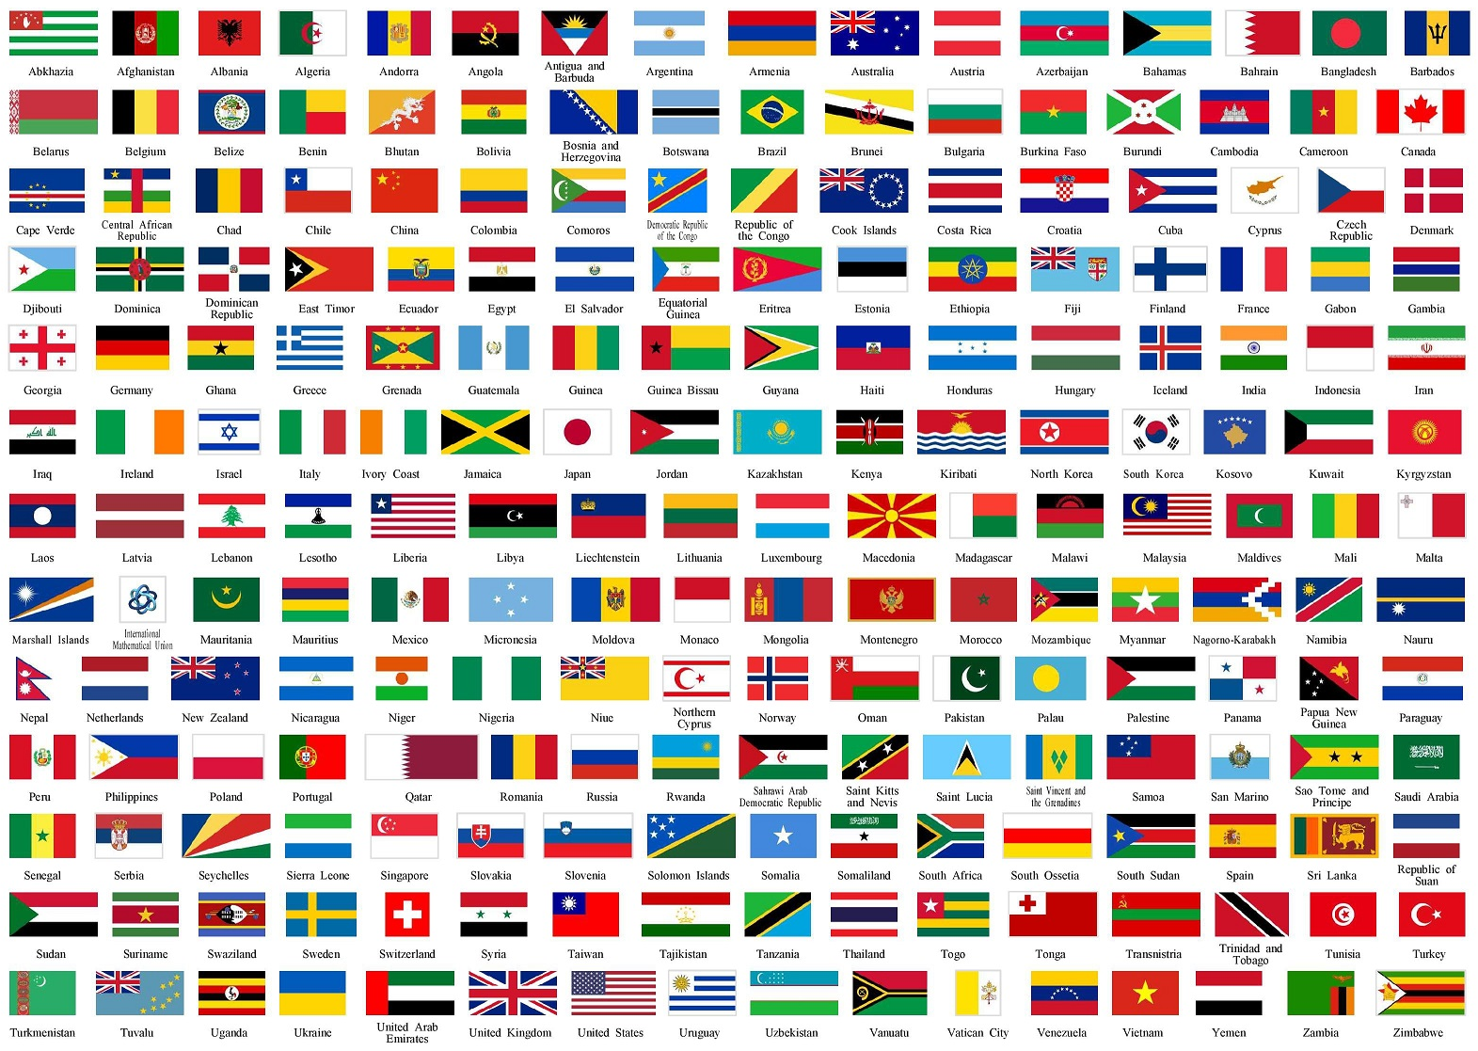
Week 2 – Art Challenge (Begins)
Flags of The World Challenge
Beginner
  Ireland, Ukraine, Peru, Bangladesh, Indonesia, Nigeria, Sudan, Colombia, France, Mali
Intermediate
  Czech Republic, United Kingdom, Switzerland, Kuwait, Tanzania, Norway, Greenland, Jamaica, Scotland, The Gambia
Advanced
  South Africa, South Korea, Greece, Chile, Seychelles, Guyana, Macedonia, Puerto Rico, Namibia, Bosnia and Herzegovina
Notes:
Begin or introduce the Flag’s of the world project.

Slide 11
Week 3 - Review
What is a Function?
  How do we set a background color?
  How do we set the foreground color?
  How do we draw a circle?
    What arguments does it take?
  What dose the stroke function do?
    How do you set the thickness?
    How do you set the color?
  How do you draw a line?
    What are the arguments?
  How do you move to a specific point?
    What are the arguments?
  How do you draw part of a circle?
    What are the arguments?
Notes:
stroke size
stroke color
stroke color, size
polygon 15, 15, -15, 15
line
moveTo x , y
Arc 0 ,1
Arc 1, 2

