Slide 1
Introduction to
Computer Systems

Slide 2

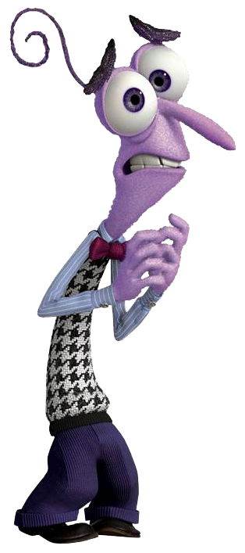



How are we doing?
Notes:
Learning something new is exciting and joyful, however; there will be times you feel like ripping your hair out.
Some of you may feel disgusted or sad if and when you can’t get something to work.
The only emotion I would like you all to throw away is ”Fear”, during this class you have nothing to be afraid of.
We will be hacking and modifying things but the best part is even if we break something it’s easy to get things working again.
By learning what not to do, you implicitly learn the right things to do.
The main thing I want all of you to do is learn something new and explore the wonderful world of computing.

Slide 3

Learning Agenda – Week 2
Introduction to Computing
  General Computer vs Embedded Systems
  Input and Output Devices
Taking a Byte our of Data Representation
  Bit, Nybble, Byte, Word, DWord, QWord
  Counting Like a Computer
  Data Representation
  American Standard Code for Information Interchange
  Data Decoder Challenge

Slide 4
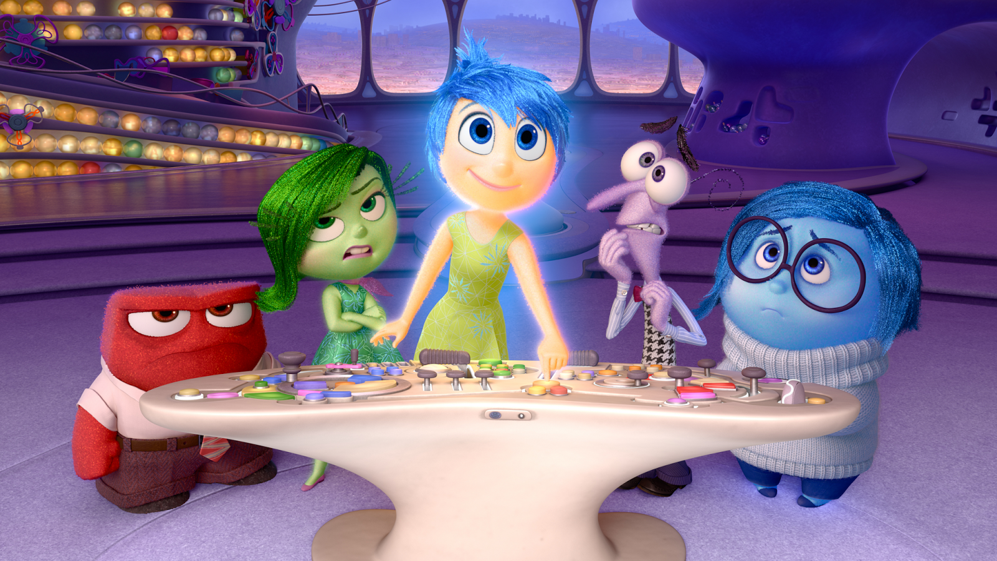
Computers vs. Embedded Systems
I WANT TO PLAY MINECRAFT AND PLAY YOUTUBE VIDEOS!!!
THIS EMBEDDED CONTROL SYSTEM ALLOWS ME TO CONTROL RILEY
Notes:
Ask the class if they know the difference between General Purpose Computer vs. Embedded System.

Slide 5
Computers vs. Embedded Systems
General Purpose Computers
Embedded Systems
Personal Computers
  Run an Operating System
    Apple (MacOS)
    Microsoft (Windows OS)
    Linux
Can be used for multiple tasks or purposes.
Allow installation of hardware and software.
Specialized computer
Single or limited purpose
Examples
  Television
  Digital Washing Machine
  Navigation System
  Airbag Control System
  Antilock Breaking System

Slide 6
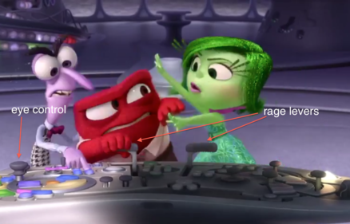
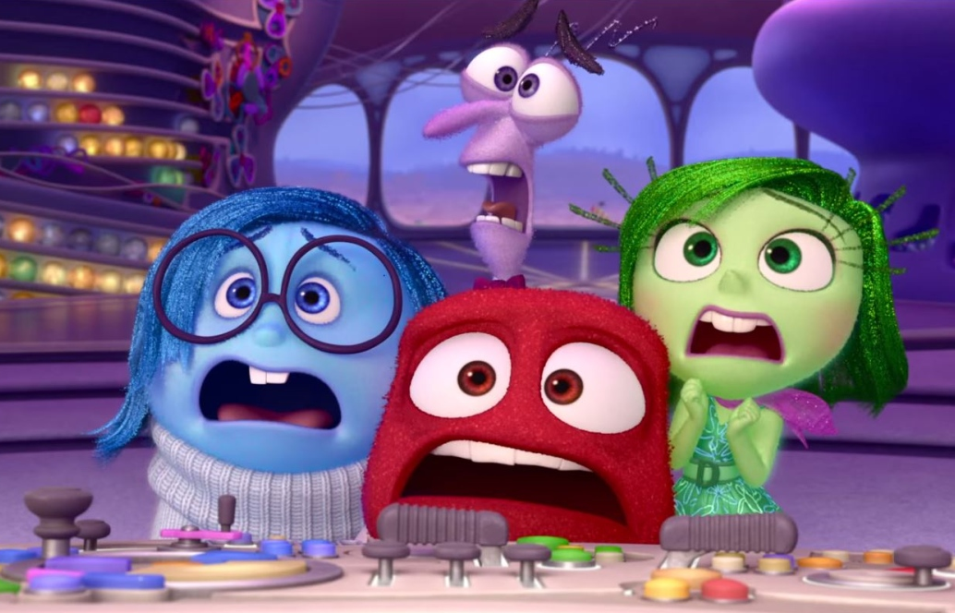
Input and Output Devices
INPUT
OUTPUT
Notes:
Ask the class to list output devices and in put devices.
Ask them what a USB hard drive is? Input or Output? Both?

Slide 7
Input and Output Devices
Input Devices
Output Devices
Keyboard
Mouse
Camera
Microphone
Scanner
Promethean Board
Joystick
Monitor (LED, LCD, CRT)
Printers (all types)
Plotters.
Projector
LCD Projection Panels
Speaker(s)
Head Phone.

Slide 8

Taking a Byte out of Data
What do you do know about data? What exactly is data?
How is data it stored?

Slide 9
Taking a Byte out of Data
Did you know that everything you do on a computer requires the processing of information? This information is referred to as “data” and data can be anything from keyboard input, digital images, or network information. How data is stored is known as “data representation.” Computers use different types of numeric codes to represent various forms of data, such as text, number, graphics and sound.
Notes:
These numeric codes are stored in “Base 2” or binary.

Slide 10
Taking a Byte out of Data
Gulp! “Numeric Codes” sounds scary. I am not a math whiz like Albert Einstein or Allen Turing.
Don’t worry! Data representation can get complicated, but we are going to keep things basic. As long as you know how to add and subtract you will do just fine. Who knows you may surprise yourself.

Slide 11
Taking a Byte out of Data – Number Systems
Did you know the number system we use as humans is called “base 10” also known as decimal? Can anyone guess why?
Computers use a number system called “base 2” also known as “binary” can you guess why?
Do you think it’s possible to have a number system greater than base 10? If so, how can you represent a digit greater than 9?
Notes:
Base 10 because naturally humans have 10 fingers.
Base 2 is used for computers because the number system best describes digital circuits “on” or “off”
Base 16 is often used to represent binary data to make it more readable for humans.
0,1,2,3,4,5,6,7,8,9,10,A,B,C,D,E,F

Slide 12
Taking a Byte out of Data – Binary Numbers
Base 2 is used by computers because the number system best describes digital circuits.
Circuits can either be “on” or “off”
Circuits can either be “1” or “0”
A single binary digit is called a “bit”
A four bit value is called a “nybble”
An eight bit value is called a “byte”
A sixteen bit value is called a “word”
Notes:
Discuss Dword(32bit) and Qword (64bit)
Double Word and Quad Word

Slide 13
Taking a Byte out of Data – Binary Numbers
Decimal (Base 10) | Hex (Base 16) | Binary (Nybble)
0 | 0 | 0000
1 | 1 | 0001
2 | 2 | 0010
3 | 3 | 0011
4 | 4 | 0100
5 | 5 | 0101
6 | 6 | 0110
7 | 7 | 0111
8 | 8 | 1000
9 | 9 | 1001
10 | A | 1010
11 | B | 1011
12 | C | 1100
13 | D | 1101
14 | E | 1110
15 | F | 1111
Notes:
It’s ok to ignore the “Base 16” or Hex column.
What is the largest decimal number we can represent in 4 bits? Answer: 15

Slide 14
Counting Like a Computer – Adding Binary
A base 2 digit can either be 0 or 1.
A base 10 digit can only be 0-9.
In base 10 when 1 is added to 9 we must “carry” a 1 to the next digit.
In base 2, when 1 is added to 1 we carry a 1 to the next digit. Let’s practice on the board to get good at this.
Notes:
Start at 0 and increment the binary number once for each student.
Show them how to get the decimal value from the binary value eg. 101 is 5

Slide 15
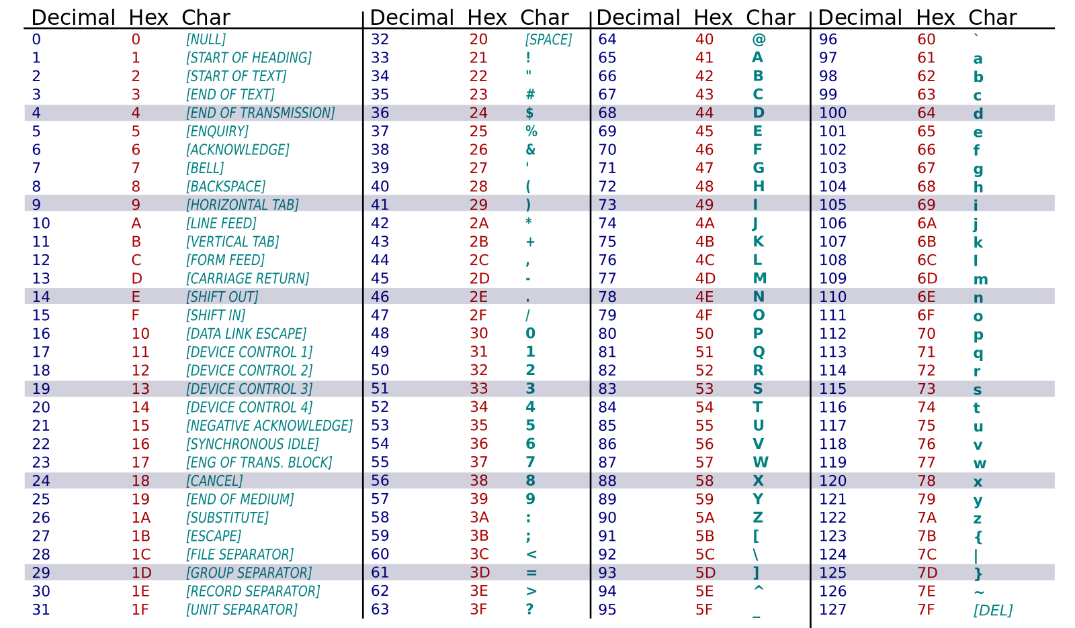
American Standard Code for Information Interchange
Notes:
Secret Message: God Is Good!

Slide 16
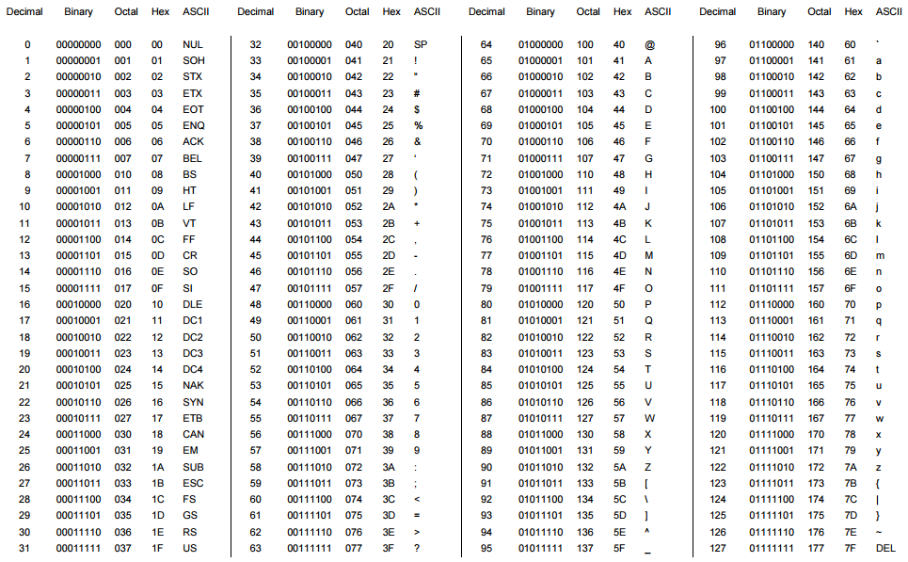
Week 2 – Data Decoder Challenge
Binary | Hex | Letter
01000111 | 47
01101111 | 6f
01100100 | 64
00100000 | 20
01001001 | 49
01110011 | 73
00100000 | 20
01000111 | 47
01101111 | 6f
01101111 | 6f
01100100 | 64
00100001 | 21
Notes:
Secret Message: God Is Good!
This can be changed to whatever the instructor wants.

Slide 17
Week 2 - Review
What is an input device? Give examples.
What is an output device? Give examples.
What is data representation and why is it important?
What is base 10?
What is base 2?
What is MSB and LSB?
Who is Allen Turing?

