Slide 1
Introduction to Raspberry Pi & Kano

Slide 2
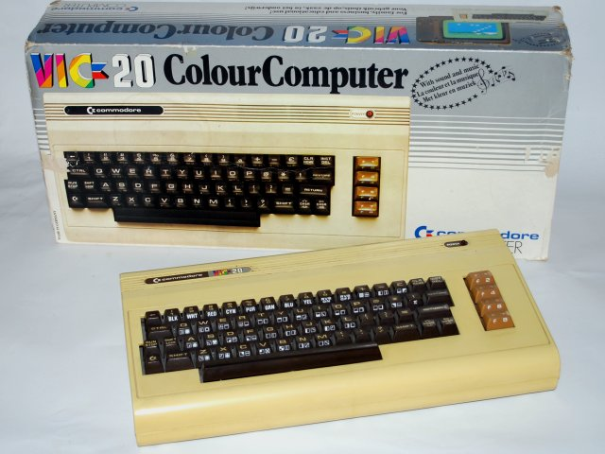
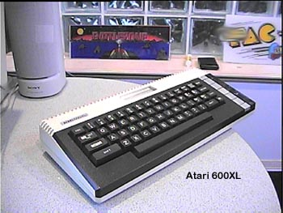
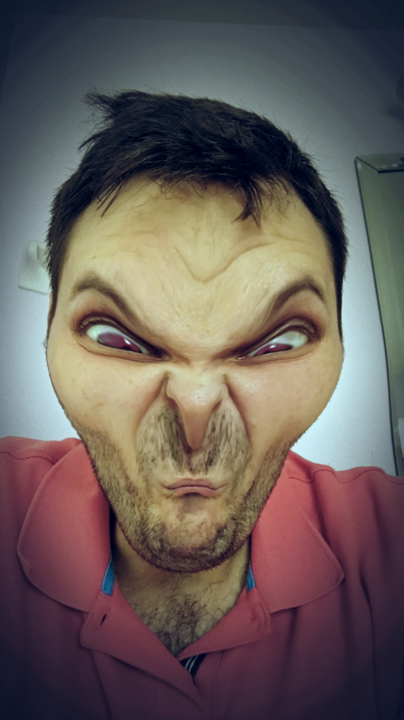
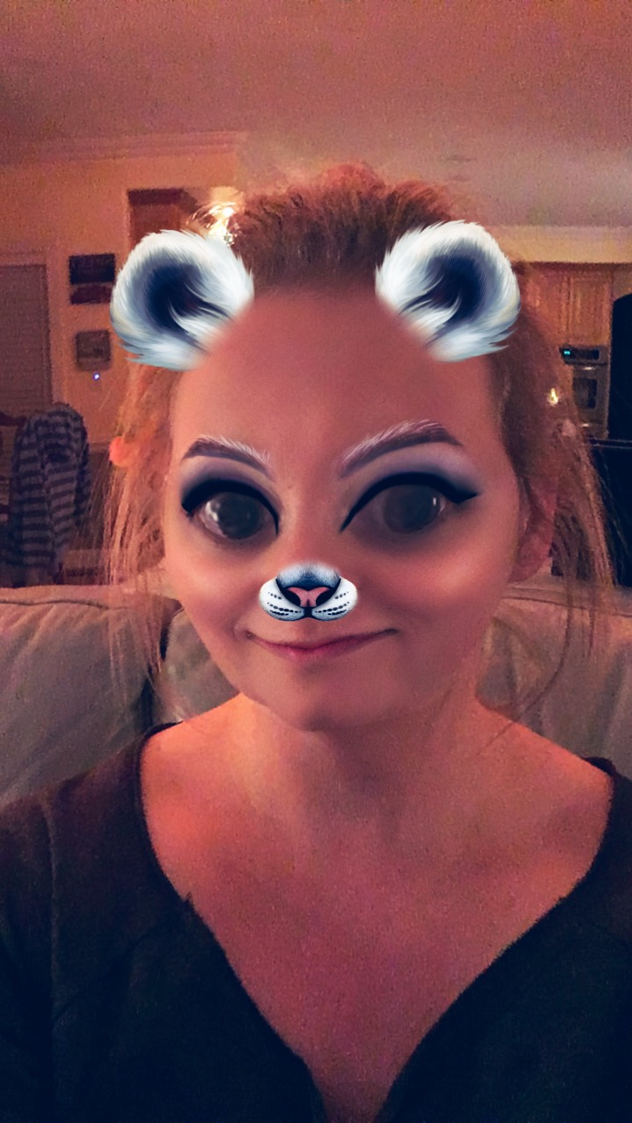
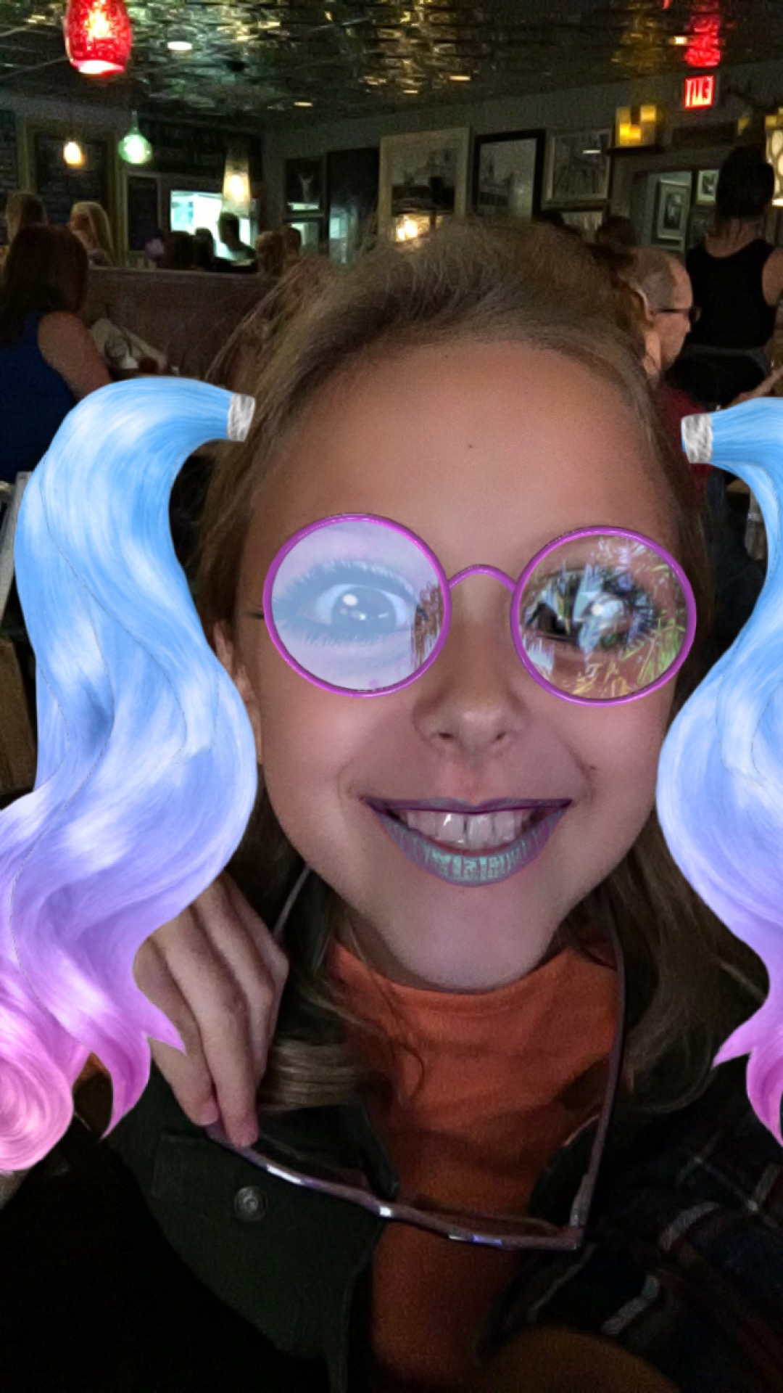
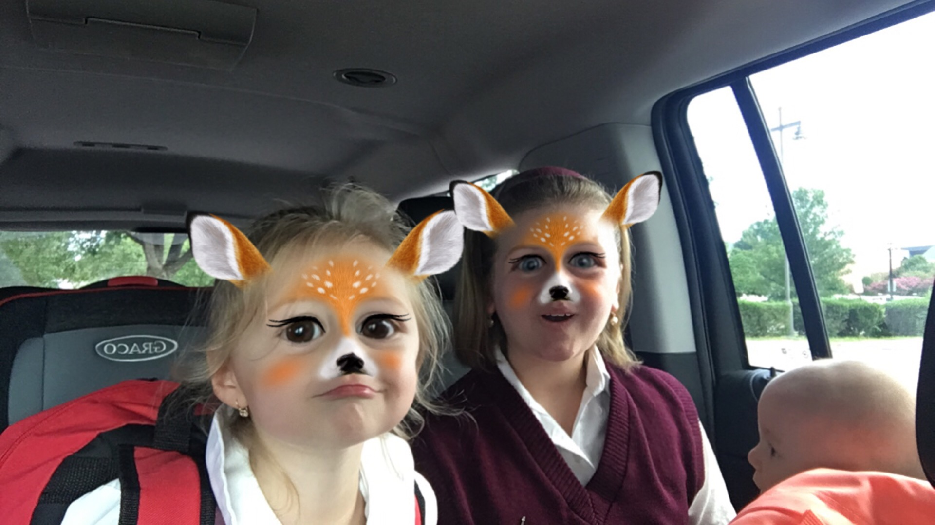
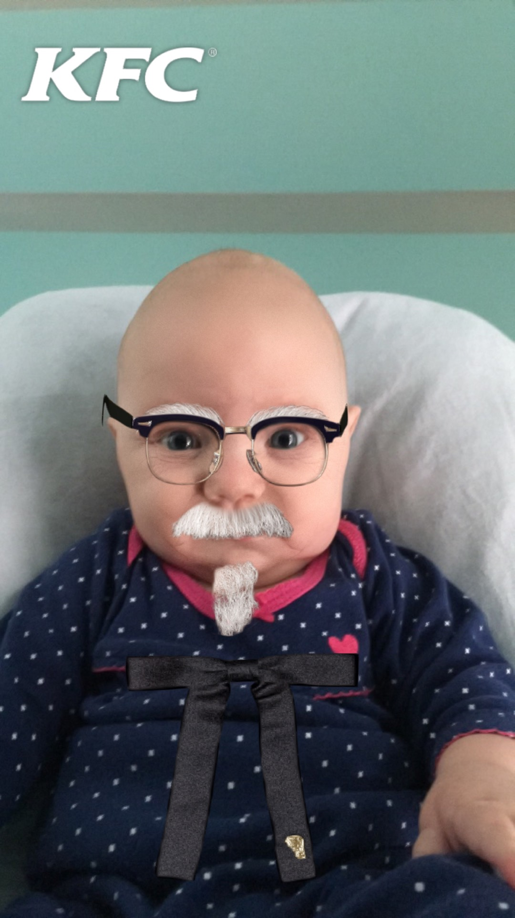
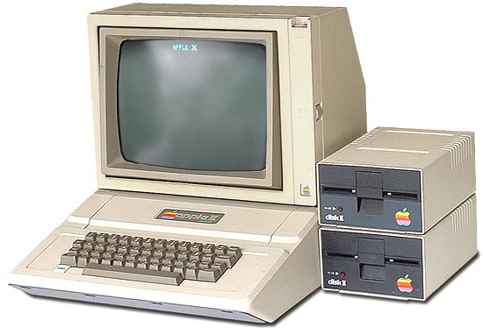
Breaking the Ice
Mr. Jerabek (Aka Lu)
Notes:
Kid story about programming in basic, was 11
My career history Siemens, My Own Company, Bank of America, Symantec, FireEye, and Proofpoint
Why I am taking the time out of the week to teach kids
My favorite app SnapChat.

Slide 3
Breaking the Ice
What is your name?
What is your age?
What grade are you in?
Why are you taking the class?
What do you want to get out of this class?
Notes:
Get a feel for what they want to learn.

Slide 4
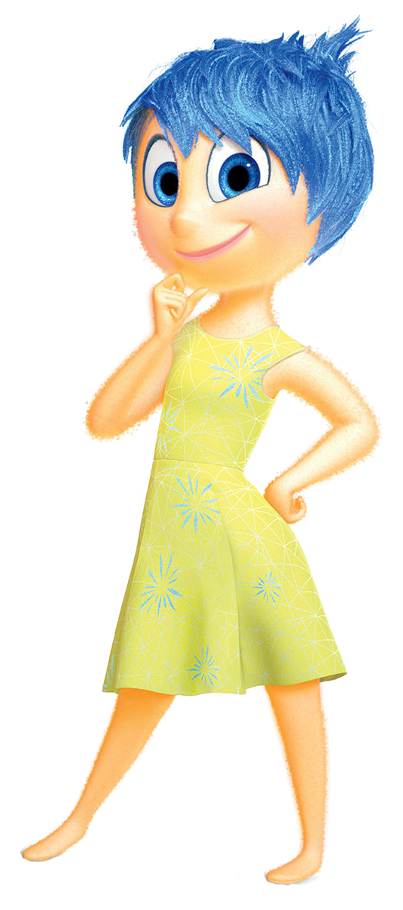
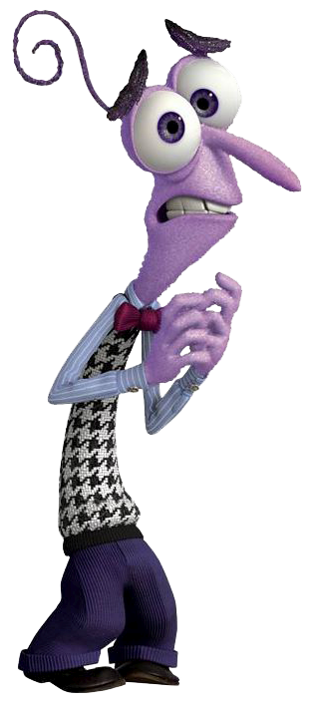
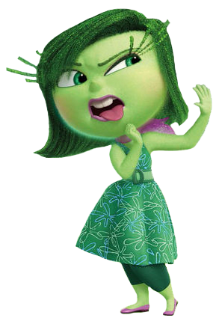
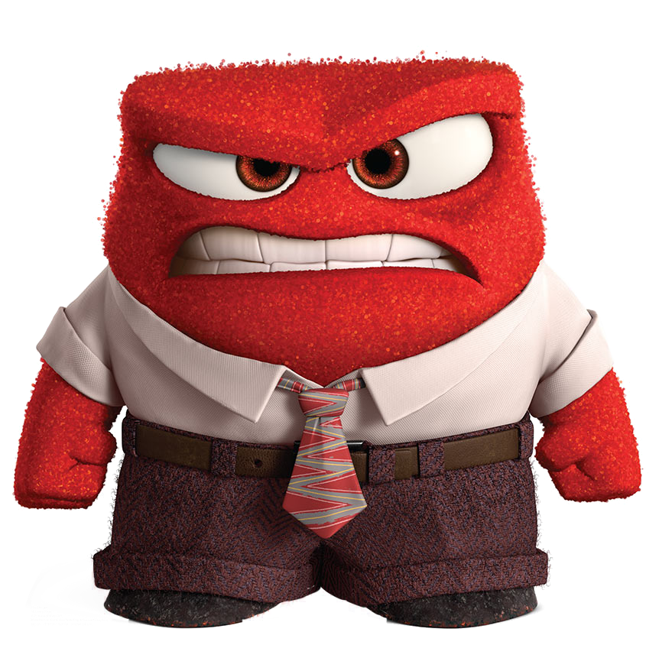
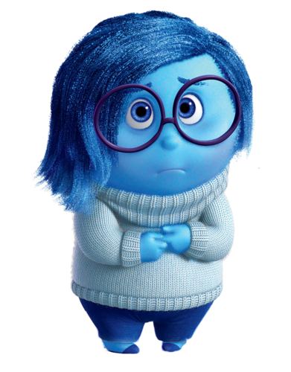
What to Expect in the Next 7 Weeks?
Notes:
Learning something new is exciting and joyful, however; there will be times you feel like ripping your hair out.
Some of you may feel disgusted or sad if and when you can’t get something to work.
The only emotion I would like you all to throw away is ”Fear”, during this class you have nothing to be afraid of.
We will be hacking and modifying things but the best part is even if we break something it’s easy to get things working again.
By learning what not to do, you implicitly learn the right things to do.
The main thing I want all of you to do is learn something new and explore the wonderful world of computing.

Slide 5
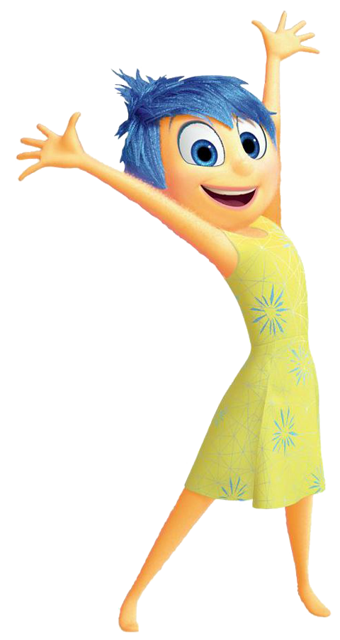
Learning Agenda – Week 1
Raspberry Pi Introduction
Say Hello to Raspberry Pi
Why Should I Care?
Baking a Pi [configuring your pi]
Inserting the SD Card (Micro SD Slot)
Connecting the Keyboard and Mouse (USB)
Connecting the HDMI Cable (or VGA)
Connecting the Power (Micro USB)
First Boot
Register a Kano Account

Slide 6
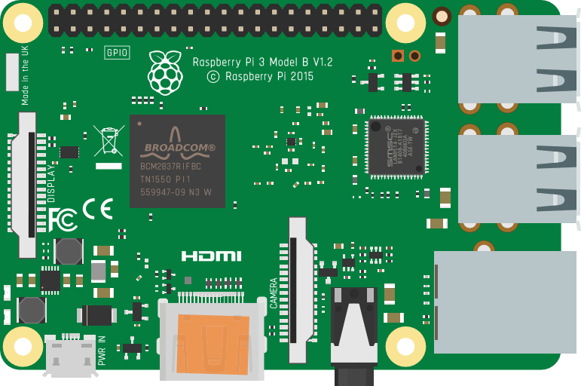
Say Hello to Raspberry Pi
INPUT/OUTPUT PINS
These help turn electricity into action.
USB PORTS
Used to extend the capabilities of the computer.
PROCESSOR
This is the brain, where tasks are and decisions are made.
ETHERNET (RJ45)
Used for wired network access.
MICRO USB
Power Connector
HDMI
SCREEN CONNECTOR
Connect to a digital display to see what your computer can do.
SOUND OUTPUT
Give the Pi the ability to speak.
Notes:
Raspberry Pi 3, is a low-cost, credit card-sized computer. The worlds first ‘Super Computer’, launched in 1956 by IBM, had a hard drive that weighted more than a ton and stored 5mb of digital information. That’s about a 30 second video on YouTube. The Raspberry Pi we are using today stores 8Gb or 8000 megabytes.

Slide 7
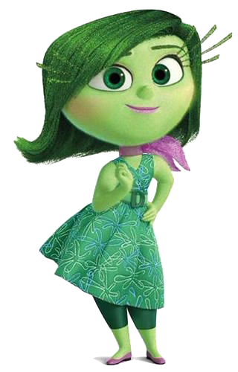
Why Should I Care?
That’s True, but have you ever wondered how it all works? Compared to the kids in the 1980’s, today’s kids are using “proprietary systems.” These devices don’t allow you to make changes to the code or explore the hardware. Limiting your ability to build, innovate, and hack.
The term "hack" is used to describe a clever way of solving a problem and the term "hacker" can be used to describe a clever programmer. Since we won’t be using our clever skills to break any laws, there’s nothing illegal about the hacking we will do.
This sounds fantastic! Since the systems we will use are not “proprietary”, we can do things like write software to control the hardware. This means we can build robots to clean up disgusting messes like oil spills. We can write software to process data and output that data as anything we can dream of.
Duh, so why should I care about a really tiny computer anyway? I have an iPad and a Samsung Galaxy.
Ok… So what is that supposed to mean? I have control over my tablet. I can turn it off and on, load apps, and browse the web.
Wow! I don’t like limits on my creativity but I am not sure about the hacking stuff. It sounds dangerous or illegal.
That’s a great question! In the 1980’s children who were learning about computers had a lot more control over the hardware.
Notes:
Have student’s who want to read roll play this if the would like.

Slide 8
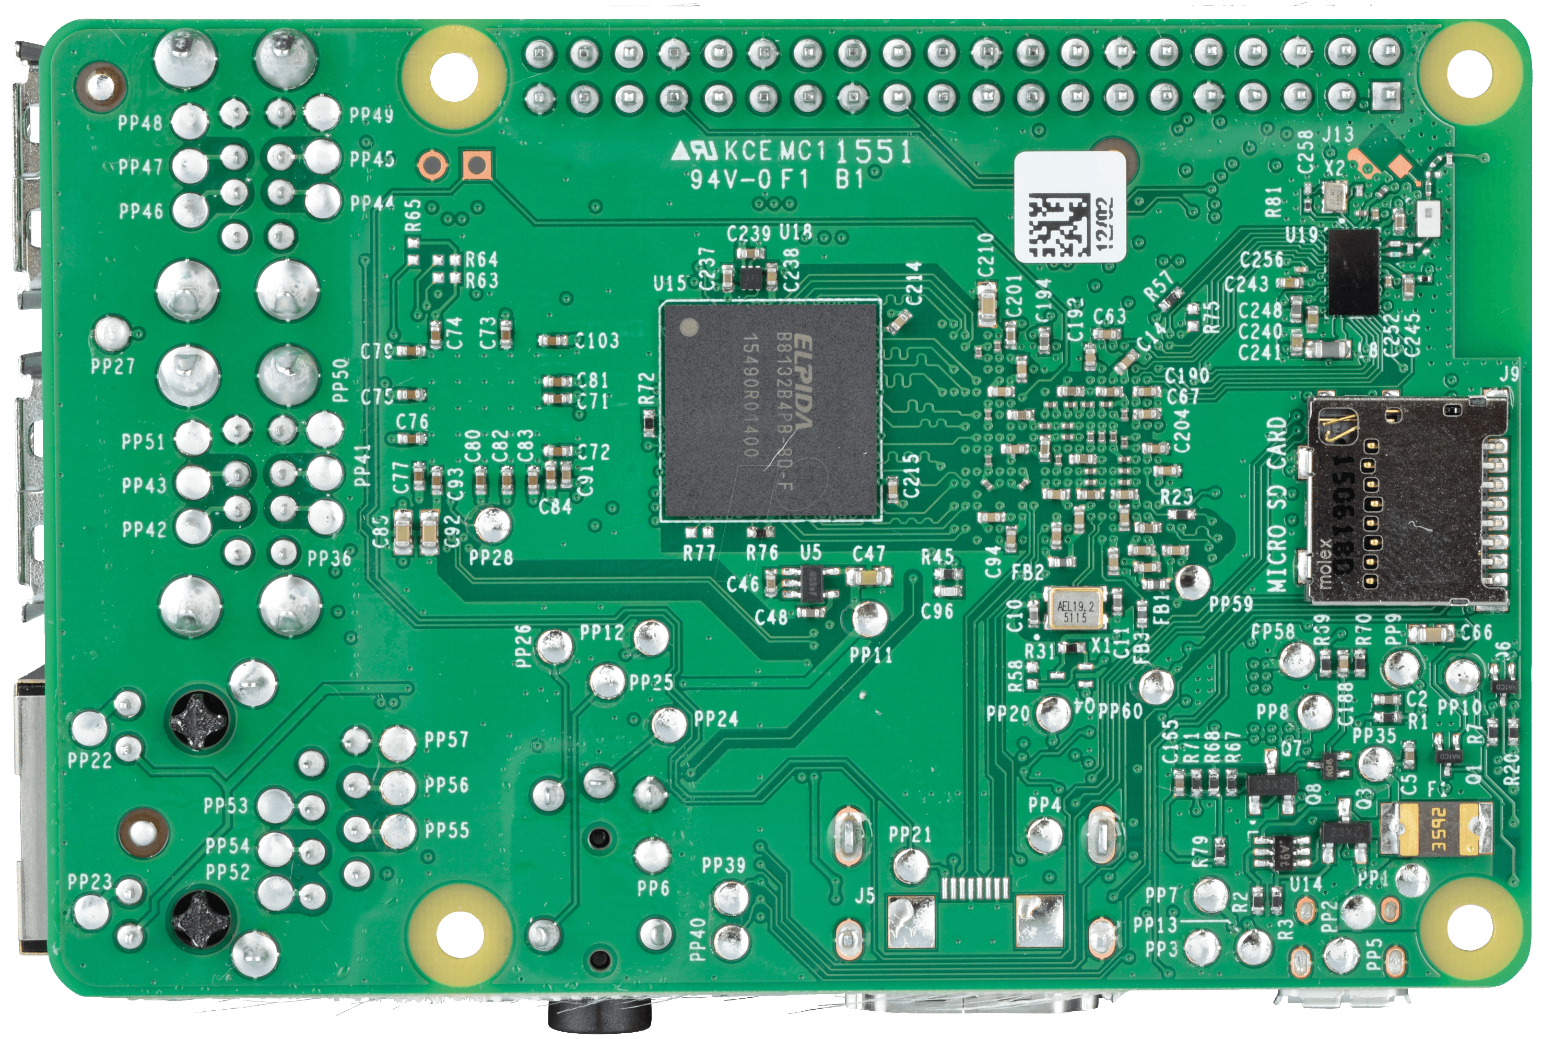
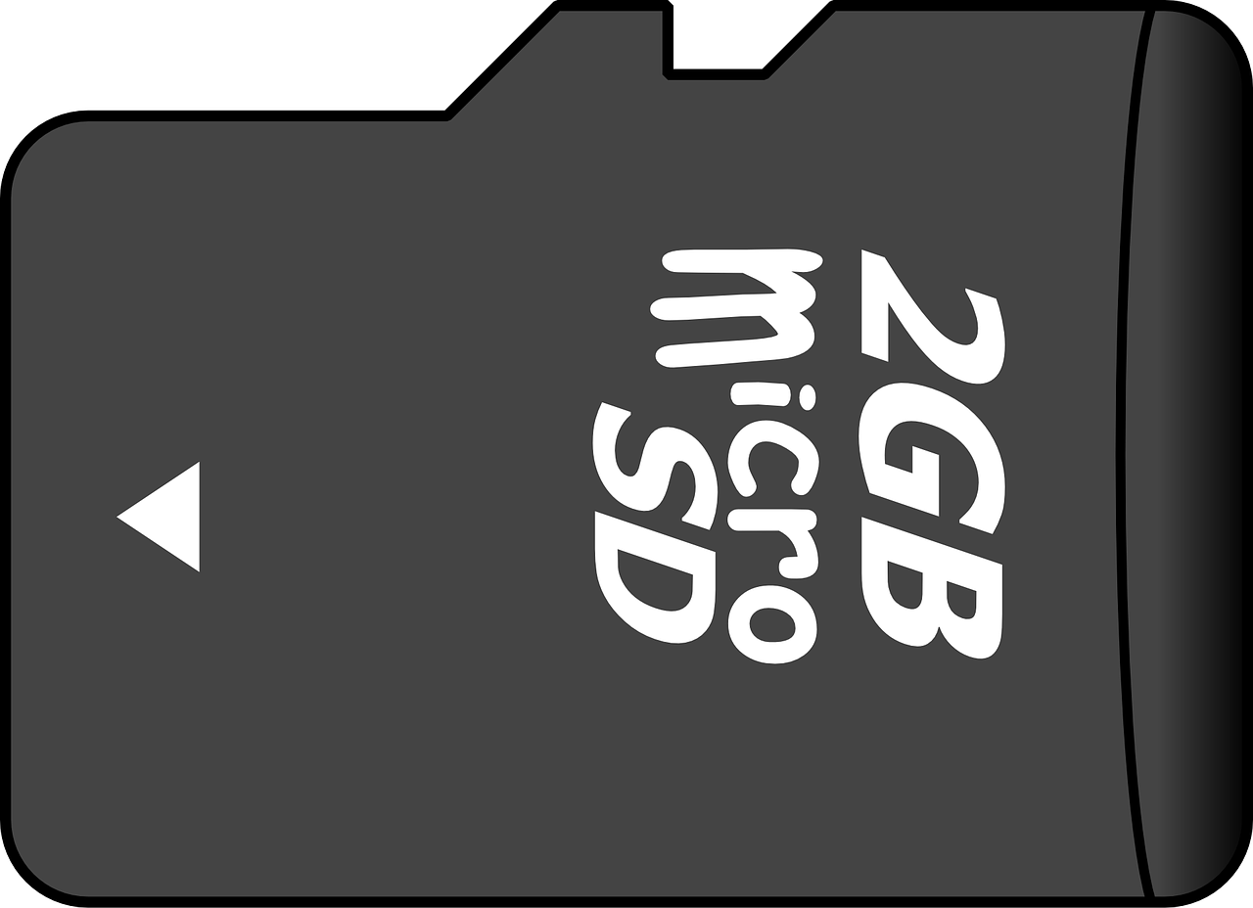
Baking a Pi – Inserting the SD card
Notes:
Time to hand out the Raspberry Pi devices and have them begin the setup.

Slide 9
Baking a Pi – Keyboard and Mouse (USB)

Slide 10
Baking a Pi – Connecting the HDMI Cable

Slide 11
Baking a Pi – Connecting the Power Cable

Slide 12
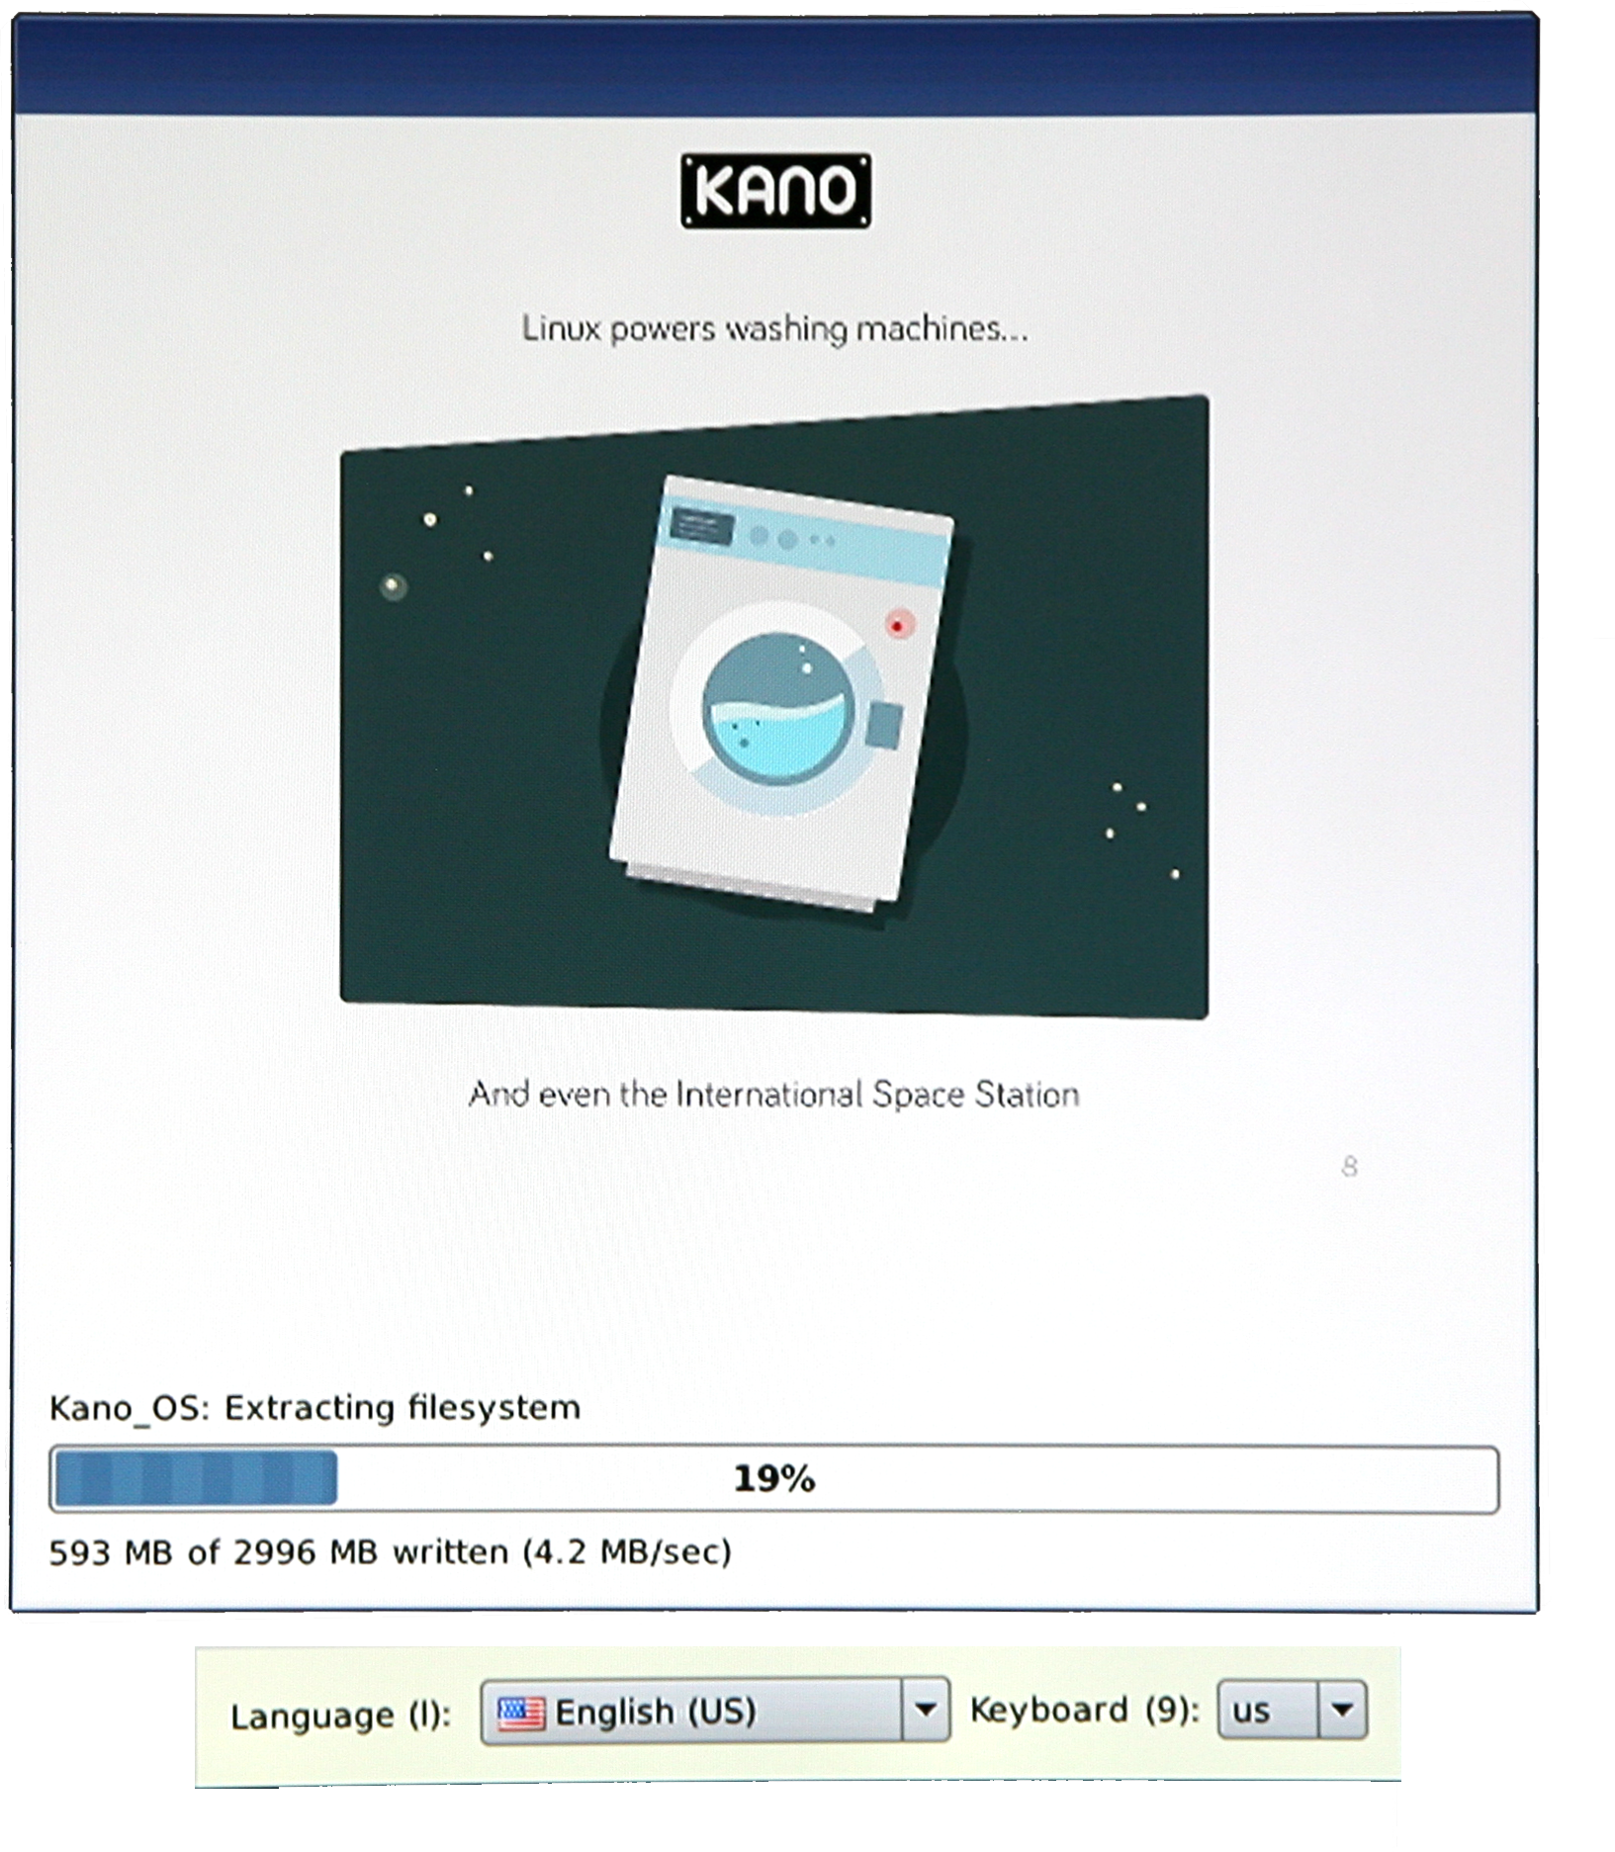
Baking a Pi – First Boot
Be Patient! Don’t Unplug!
SD Card is Resized
OS is installing itself to the rest of the SD card
Make sure you select the correct language “English (US)”
Notes:
Instructor should have a fresh install of Kano on Pi to walk them through the process.
Be sure the have them select the Language to “English US” and set keyboard to “US”

Slide 13
Installation In Progress
Ask for help if you are stuck!
Notes:
Walk around and make sure everyone is up and running.

Slide 14
Week 1 - Review
What is a Raspberry Pi?
Why is it cool?
How many USB ports are on a Raspberry Pi?
How what connector is for Video Output?
What can be done with the GPIO pins?
Why does the Raspberry Pi need an SD card?

